Slide 1
Developmental Education Summit
Multiple Measures Pilots Panel

Slide 2

Developmental Education Summit
Friday, September 28th

Slide 3


Pilot Overview
For students one level below college-level Reading and Mathematics on ACCUPLACER
Participants randomized: 70% of tester in pilot group; 30% in control group
Those in pilot group with EITHER at least a 3.0 cumulative high school GPA or a score above the 50th percentile on the LASSI motivation scale were given college-level placements in those subjects
All students meet with advisor to discuss options

Slide 4

Key Challenges/Successes
Randomization code was frustrating
Unsure of predictive reliability of LASSI motivation scores as non-cognitive indicator of success
Time consuming to manage
More students bumped up 93/1336 (P) 1564 total
All built within ACCUPLACER, so involved few people
Allows for more measures of success than one standardized test

Slide 5
Lessons Learned
Designing the plan with faculty and communicating it broadly is critical
Placement touches almost everyone
Include both Academic and Student Affairs
Once selected, stick with the method for at least two semesters before making changes
Gather data, and then ACT on it
Placement requires human nuance; automation is not perfect

Slide 6

Developmental Education Summit

Slide 7
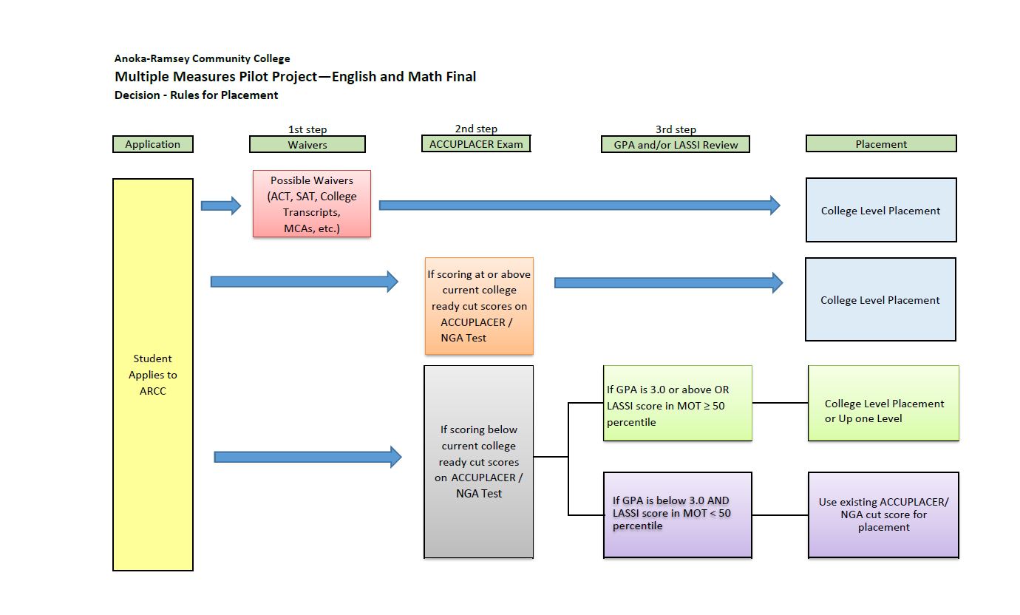
Anoka-Ramsey Decision Rules

Slide 8
Pilot Overview Anoka-Ramsey
2645 students tested between May 18 and Sept. 17
1635 students were part of the pilot
829 control – all test data collected
806 experimental – meaning they were given the option to enroll in the next higher level

Slide 9
Key Challenges
1) We found we lacked the infrastructure needed to efficiently pull together all data points in a timely manner.
2) Difficulty communicating the process and implications of results to students

Slide 10
Key Successes
1) We proved we could do it! Communicated and implemented a new testing / placement process
2) Hired a testing / placement advisor

Slide 11
Lessons Learned
Needed to trade immediate access to testing and placement for a more structured approach. We are hoping this new approach results in better placement.

Slide 12

Developmental Education Summit

Slide 13
Pilot Overview
Representative team from across campus spent a year researching and revising our placement processes
  Developmental educators, other faculty, research, admissions, IT…
A comprehensive scan of our local data revealed
  Current process was only about 55% accurate
  “Accu”placer is not a good predictor of student success
  Significant emotional impact on students
  Significant placement gaps between students of color and white students
  Using high school GPA in placement can significantly increase accuracy and close placement gaps
  Non-cognitive instruments show promise, but we need local data to use them reasonably
Used simulations (and a lot of discussion) to optimize and finalize our placement rules

Slide 14
Pilot Overview
Placed 50% of new Fall 2018 students who went through placement testing using new methods
  Using a randomized control trial that will allow us to assess the impact of our revised processes
All students completed a non cognitive assessment (LASSI)
  Meta analyses show that LASSI predicts success above and beyond high school GPA
  Primary goal is to gather data we can use in future
For students who have submitted a high school transcript, placement was based on high school GPA or Accuplacer
  Whichever resulted in higher placement
Students without High School GPA received a modest bump if LASSI showed high motivation

Slide 15
For students who have not submitted a high school transcript, they are bumped up one level if they have a high motivation score (LASSI motivation score >= 75th percentile)- Conservative guess
 | Writing/ Reading | Math
College Level | High School GPA >=2.5 or Accuplacer | High School GPA >=2.7 & successfully complete Algebra 2 or higher or Accuplacer
ENGC/READ: 9xx MATH: 9xx/630/60x | High School GPA >=2.0 or Accuplacer | High School GPA >=2.0 or Accuplacer
ENGC/READ: 8xx MATH: 60x | High School GPA >=1.7 or Accuplacer | High School GPA >=1.7 or Accuplacer

Slide 16
Key Challenges/Successes
Successes
  Representative team that really worked on this problem
  Shared analysis of data
  Fairly automated placement process
  Collaboration/funding from MDRC
  We are closing placement gaps
  We are using the gold standard for testing impact
Challenges
  Communication
  Uncertainty (Next Gen, system policy, …)
  Access to high school GPA (currently getting from about 50% of students)
  History – we haven’t necessarily been systematic about this in the past

Slide 17
Lessons Learned
This takes time
  To design a good process
  To implement
  To discuss
  To evaluate
This is very personal, we all want to maximize student success, but may have different ideas about how to do this – make sure to maximize
  Involvement
  Communication

