Slide 1
Accelerated Developmental English & Reading at Century College
Presented by Dana LeMay, English | LuAnn Wood, Reading |Stacey Wollschlager, Reading
Angela Coffee, English | Amy Fladeboe, English
2017 Minnesota Association of Developmental Educators

Slide 2
The Unintended Consequence of Remediation Policies
The more levels of developmental courses a student must take, the less likely that student is to ever complete college English or Math.
      Bailey, Thomas. (February 2009). Rethinking Developmental Education. CCRC Brief. Community College Research Center. Teachers College, Columbia University.
*Slide from 2016 CADE pre-conference workshop, used with permission from Katie Hern

Slide 3
Placement as Destiny
Mt. San Jacinto College Data – Fall 2015 – English
White students were 2x more likely to be placed into transfer-level English than Hispanics and nearly 4x more likely than African Americans
  Chance of passing college English in 2 years for White students: 73%
African American and Hispanic students were more than 2x more likely that white students to have to take multiple semesters of remediation in English
  Chance of passing college English in 2 years for Black/Hispanic students: 23%-38%

Slide 4
Our previous model
Reading 80
Reading 90
Comp I
English 80
English 90
Every arrow or gap in a sequence represents a 20% reduction in the population size.
On average, every 100 students placed at the pre-pre-college level, only 20 of them got through Comp I.

Slide 5
Halfway there!
Excellent Read
5 credit hours
Intro to Writing
4 credit hours
Composition I
OR
OR
Reading 950
3 credit hours
English Express: Intro to Writing + Composition I
8 credit hours

Slide 6
We have arrived.. we think.. please, God.
Composition I
4 credit hours
Academic Literacy
+ Excellent Read
8 credit hours
OR
English Express:
Intro to Writing + Composition I
8 credit hours

Slide 7
English Express: Co-requisite Placement

Slide 8
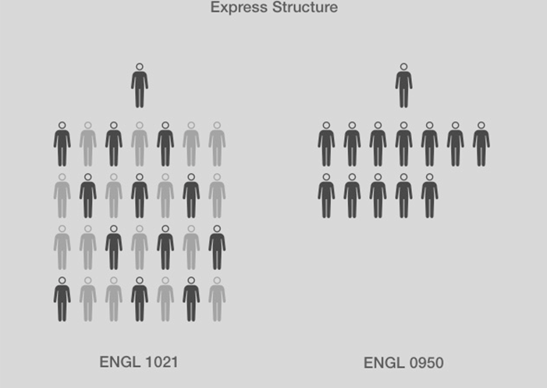
Century’s Express English Structure:
Our model replicates much of the Baltimore ALP model:
In the same semester, with the same teacher, students testing into the upper half of our developmental population take our Express English class WITH Composition I.

Slide 9
Our English Express data..
Traditional basic writing, pre-college class through college-level class success:
English Express college-level co-requisite (aka Baltimore model)
ENGL 0090 student pass rate of ENGL 1021: 46%
  White: 45%
  Asian: 51%
  Black/African American: 42%
  Hispanic: 40%
Express student pass rate of ENGL 1021: 65%
  White: 66%
  Asian: 69%
  Black/African American: 66%
  Hispanic: 62%

Slide 10
How did we do it?
The latest research by Wood and Barhoum, which we’ll review after lunch, suggests the following four measures have contributed more to our success:
Structural Changes (co-requisite model, eliminating pipeline)
Curricular changes (backward design, integrated reading)
Andragogical/Pedagogical (training, ongoing discussions and collaboration with colleagues)
Relational/Equity work (SEED, ICRP, On Course)

Slide 11
Underlying assumptions and policies that drive effective practices
Checking our assumptions about developmental students:
Can’t handle college-level work
have less self-discipline
aren’t motivated
should have known better
are making bad choices
Checking our policies:
Flexible deadlines and attendance policies
teacher vs guide
Front loading vs just in time remediation and in-context
high stake assessment tools vs low-stakes scaffolding to larger projects
“trust me- you need this” vs “let me show you how you’ll use this”

Slide 12
Academic Literacy: Pre-requisite Placement

Slide 13
Academic Literacy
Population served: students determined by entrance placement tools as not yet “ready” for Express
The new course is modeled after CCBC’s Academic Literacy course, which is modeled after CAP’s Accelerated Integrated Reading and Writing course.
It is a fully integrated Reading and Writing course.

Slide 14
Academic Literacy’s Learning Outcomes
use pre-reading and reading strategies to facilitate understanding of texts.
read actively and critically.
use annotation effectively.
employ a variety of strategies for building academic vocabulary.
identify abstract ideas found in complex academic texts.
deconstruct abstract ideas found in complex academic texts.
explain valid inferences based on information in texts.
evaluate arguments for validity and credibility.
synthesize ideas and information from multiple sources and varying points of view.
write well-organized, unified, and coherent essays with a thesis statement.
evaluate the validity and reliability of sources.
support ideas with adequate and varied evidence.
tailor language to address a specific audience.
detect and correct grammatical and mechanical errors.

Slide 15
Academic Literacy: Major Outcomes
Academic literacy and academic discourse
Independent, sustained reading
Text-processing strategies
The reading-writing process
Academic vocabulary building
Organization of ideas
Critical reading, writing, and thinking
Response to academic texts
Evaluating and using source materials
Audience awareness
Writing and evaluating arguments
Grammar, punctuation, spelling, and usage

Slide 16
On placement: The English Placement Exam
Because placement is destiny, we’ve committed to revamping our placement policies, too.
Students take the EPE in their Reading classes to determine if they would benefit from additional support such as ESL courses and/or Express or if they ready to jump right into college-level Composition.

Slide 17
The exam
Students have 50 minutes to complete the exam. They receive their results in time for registration in week 11 of the semester.
Here is the exam the students see: https://goo.gl/forms/vV1ktA8umXUU9b5v1
Faculty submit placement recommendations for their students here: https://goo.gl/forms/hPUxSZpDJXXFV0hN2
English faculty read the exam essays and submit their recommendations here: https://goo.gl/forms/i8pYzhxW1v0dbhib2

Slide 18
Placement and results
A student “jumps ahead” to college-level Composition when their current instructor and two readers place them into the course
  Fall 2016: 35 students jumped right into college-level Comp
    So far, 75% of these have gone on to earn an A or B in Comp I
  Spring 2017: Of 140 tests, 21% go directly into Comp I (30 students) and the other 79% are EXP/90 eligible (90 students)

Slide 19
Additional works cited…
Adams, Peter. “Original Sin and Reemption: Developmental Education in the 21st Century.” CADE, 2016. alp-deved.org, http://alp- deved.org/2016/06/original-sin-and-redemption-developmental-education-in-the-21st-century/
Hern, Katie. “Preconference Workshop: Inside an Accelerated, Integrated Reading & Writing Classroom.” CADE, 2016. alp-deved.org, http://alp-deved.org/2016/06/preconference-workshop-window-into-an-accelerated-Integrated-reading-and-writing-course/
“Historical Facts.” Harvard.edu. 2016. http://www.harvard.edu/about-harvard/Harvard-glance/history/historical-facts
U.S. Department of Education. “Vocational Education in the United States: The Early 1990s.” National Center for Education Statistics, November 1995. NCES.gov, http://nces.ed.gov/pubs/web/95024-2.asp

