Slide 1
Open Educational Resources (oer) for Developmental Education
MNADE Conference
Thursday, September 27, 2018
Cragun’s Resort, Brainerd, MN

Slide 2
Beginning with OER
Cindy Bunting, Anoka Ramsey Community College
I began by registering for Karen Pikula’s 90 minute introductory webinar.
Next, I researched a variety of websites:
Resources
Libguides
http://libguides.rutgers.edu/c.php?g=336435&p=2265847
BCcampus OER Resources
https://bccampus.ca/open-educational-resources-oer-teaching-resources-bccampus/
Wikibooks
https://en.wikibooks.org/wiki/Main_Page
Saylor Open Course Resource Center
http://www.saylor.org/open/

Slide 3
Additional OER Resources
80 Open Education Resource (OER) Tools for Publishing and Development Initiatives
http://oedb.org/ilibrarian/80-oer-tools/
College Open Textbooks
http://www.collegeopentextbooks.org/
Flipbook
http://anyflip.com/
Open Educational Resources Used in Various Colleges and Universities These lists and links are harvested from the Community College Consortium for Op
http://www.ltcconline.net/greenl/oer/oerlistfromlistserve.htm
Accessibility of Office Documents and Office Applications This site can help you create accessible office documents and choose accessible office applications
http://adod.idrc.ocad.ca/
Waymaker Computer Apps for Managers
https://courses.lumenlearning.com/wm-compapp/
Wikimedia Commons
https://commons.wikimedia.org/wiki/Main_Page

Slide 4
Additional OER Resource Links
Additional Resources | Direct Links
Community College Consortium for Open Educational Resources: https://www.cccoer.org/ Open Textbook Library (From the University of Minnesota): http://open.umn.edu/opentextbooks/ OpenStax: https://openstax.org/ College Open Textbooks: http://www.collegeopentextbooks.org/ Anthropology: Websites http://library.hccs.edu/guides/anthropology/websites Wisc - Online OER https://www.wisc-online.com/ | OER Commons MERLOT Connexions Internet Archive FREE: Federal Resources for Educational Excellence COL Knowledge Finder Creative Commons OpenDOAR Curriki Hippocampus Edu2.0 More Content Sources

Slide 5
Helpful Tools to Organize Research provided by Karen Pikula
Textbook Resource Comparison Matrix
Chapter | Items Covered in Currently Used Textbook | Items Covered in OER Material being Reviewed | Items NOT Covered in either that should be… | Notes to me…
Chapter One
Chapter Two
Chapter Three
Chapter Four
Chapter Five
Chapter Six
Chapter Seven
Chapter Eight
Chapter Nine
Chapter Ten
Chapter Eleven
Chapter Twelve
Chapter Thirteen
Chapter Fourteen
Chapter Fifteen
Chapter Sixteen

Slide 6
Adapted Tools for multiple texts
First Year Experience OER Research July 2018 By Cindy Bunting
OER Title |  | Title: College Success | Title: A Different Road To College: A Guide For Transitioning To College For Non-traditional Students Author: Alise Lamoreaux | Title: Blueprint for Success in College and Career Subtitle: v 1.1 Author: Dave Dillon | Title: College Success This one has more video supplements than the other “College Success” A Close Match! | Title: Student Success by Lumen Learning Love the Supplements, Graphics, Quizzes, To the point! A Close Match!
Link | Items Covered in Currently Used Textbook | http://open.lib.umn.edu/collegesuccess/ | https://openoregon.pressbooks.pub/collegetransition/ | https://press.rebus.community/blueprint2/ | https://courses.candelalearning.com/collegesuccess2xmaster/ | https://courses.lumenlearning.com/collegesuccess-lumen/

Slide 7
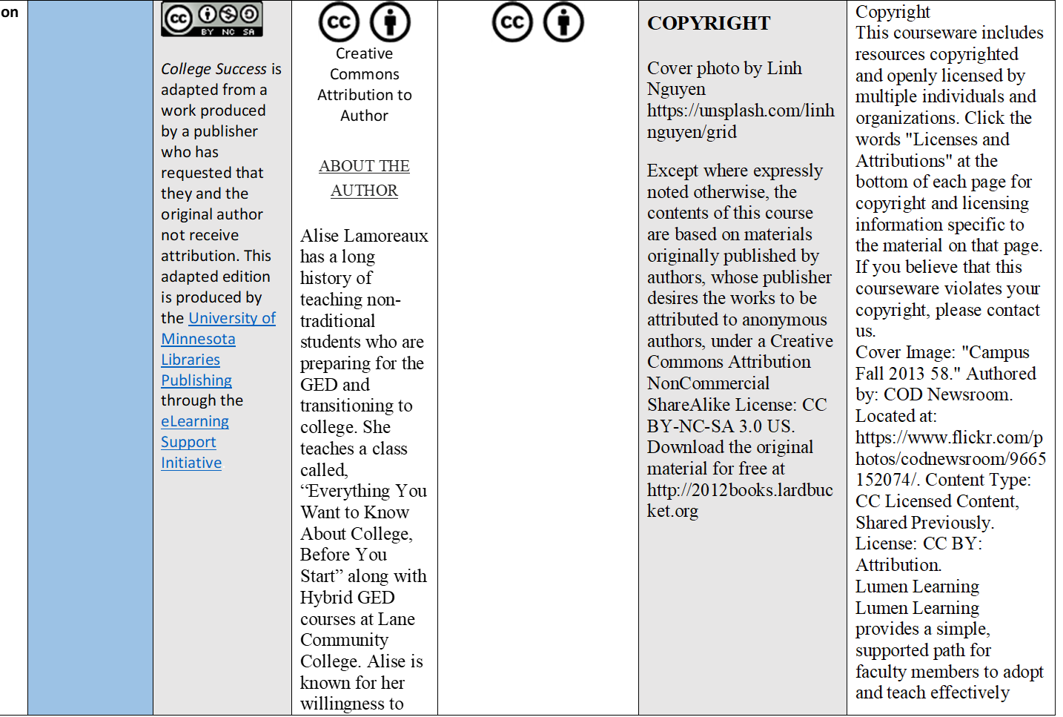
Publication Notes

Slide 8
Cross Chapter Comparison
Chapter 1 | Welcome |  | Introduction Chapter 1: What’s College For?
Chapter 2 | College Knowledge | Ch. 1 You and your college exp 1.1 Who Are You, Really? 1.2 Different Worlds of Different Students 1.3 How You Learn 1.4 What Is College, Really? 1.5 Let’s Talk about Success 1.6 Chapter Activities | Chapter 2: Choosing A College To Attend Supplemental Fun Chapter 4: Speaking The Language of College Chapter 6: Navigating The College Website Chapter 10: College Resources | Unit 1: Launch Chapter 1: Passion Chapter 2: What’s College For? Chapter 3: Words of Wisdom: The Student Experience Chapter 4: Choosing A College To Attend Chapter 5: Words of Wisdom: Practice, Practice, Practice Chapter 6: Evolution To College: Becoming A College Student Chapter 7: Speaking The Language of College Chapter 8: Words of Wisdom: Why So Many Questions? Unit 1: Chapter 10: Navigating The College Website | Ch. 1 You and Your College Experience Who Are You, Really? Different Worlds of Different Students What Is College, Really? Let’s Talk about Success Chapter Activities - You and Your College Experience Discussion: Introduction | CH. 1 Introduction to College Success · Introduction to College Success

Slide 9
Narrowing OER Resources
My reviews
 |  |  |  | Chapters/Topics We did not specifically cover in a whole chapter: Navigating the College Website With a Little help from my friends (interrelationship) Mental and Physical Health Career Explorations Conclusions Book Final Picks | Chapters/Topics We did not specifically cover in a whole chapter: Learning Style College Reading College Writing Health Finances Future/Career Includes: Content Text/Graphics Ojbectives Activities Key Takaways Exercises Outside the Book Takaways 1st Video is in Chapter on Time Management Table of Contents with Links Book Final Picks | Chapters/Topics We did not specifically cover in a whole chapter: Learning Style Mental and Physical Health Financial Management Career Exploration Wrap up Includes: Video Learning Objectives Activities Video/Links Self-Assessments Quiz Links Quotes Table of Contents with Links Book Final Picks

Slide 10
Idea from the text: Blueprint for Success in College and Career
Videotape a Student Panel on OER: 5 Students
Santa Ana College OER Student Panel OpenEd 2017
What courses were you enrolled in that incorporated OER? Pass the mike
Compared to traditional textbook courses, what have you noticed about OER resources?
What benefits have you experienced while using OER materials?
How much of a factor was the cost of your course materials and course selection?
What advice do you have for faculty who used OER in your classes? (break it into modules and make it interactive and learning styles and add a voice, more personalized and fun)
What advice do any of you have for faculty who have not yet implemented OER?
Now that you know about OER, what are you going to do now?
Based on your experience with OER, what is your feeling for the need and use of printed materials? (OER is mobile friendly, faster, lose printed materials, its green – save trees, can print from online, can highlight and write notes and add notes to page, search notes, option to print on recycled paper, some students are still waiting for their books)
Is there anything else you would like to add? (math videos were helpful, not easier, you still work hard to earn an A)
Questions from audience: I work with faculty in Georgia, quality: Have you worked with the material and questioned the quality of the OER material? (More up to date, how an instructor develops the course)

Slide 11
Using an OER-based packet in a Reading course
Celeste Mazur, Saint Paul College
Textbook OER-based packet
3 OER textbook chapters + handouts
Color copied $15 student cost in the bookstore or online PDF at no cost
More prep, some collaborative
MinnState OER Learning Circles
Revised packet; learned about OER; structured work time
Created ancillary materials to accompany packet

Slide 12
Four things to evaluate
Linda Russell
Content accuracy and scope appropriate for course.
Readability levels/range. Nominalization of language. Complex sentence structure. Check the later chapters that may be more complex/difficult. Look for consistency across chapters. Example of nominalization:
  The movement in the liquid medium of the bacteria was accomplished by microflagella.
  The bacteria move themselves in the liquid medium with microflagella.

Slide 13
Four things to evaluate, continued
Comprehensibility.
  Meaningful headings
  Vocabulary addressed in a clear and systematic way
  Graphics (photos, drawings, diagrams, charts, graphs) are helpful
  Text features, such as color (used systematically), guiding questions either within or at the end of the chapter
  Table of Contents
  Index so that students can find information later
  No obvious typographical or other writing errors. These kinds of errors can be very difficult for English Language Learners or students whose reading and vocabulary skills are lower.
Permissions: check for Creative Commons licensure or some other permissions language to make sure you may use the material in the way you intend.

Slide 14
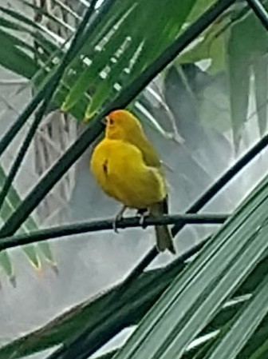
Building Academic literacy
Lori-Beth Larsen- Central Lakes, Kathryn Klopfleisch- Inver Hills
Skills we will help developmental students master:
  Reading college level material
  Getting the most out of a lecture
  Participating successfully in discussions
  Writing an academic essay
Book Structure:
  Emphasize process
  Three stages–
    Warm up
    Work out
    Cool down
Notes:
Lori Beth and Katie

Slide 15
Systemwide offerings and professional development opportunities
Karen Pikula
Please visit www.tinyurl.com/MinnStateFacDev
Open Textbook Network Webinars
Webinars introducing open educational resources, creative commons licensing,
Network and the work with the Open Textbook Library at the University of Minnesota. Faculty participating in this webinar may review an open textbook located in the Open Textbook Library (open.umn.edu) and receive a $200.00 honorarium once the review is completed.
OER Librarian's Workshop Day
This is a full-day meeting especially for librarians committed to expanding and supporting the use of OER by instructional faculty.
OER Learning Circles
OER Learning Circles provide faculty, from across the system and from any discipline, the opportunity to collaborate with others committed to redesigning courses and/or creating materials to eliminate textbook costs for students. In addition to virtual weekly meetings, OER Learning Circles will utilize a D2L Brightspace course to support faculty and will take place over a ten-week period. The equivalent of a one-credit release is available to participating faculty.
Koffee with Karen: OER Community Conversations
These are open forum conversations for all to share, discuss, and learn from colleagues in the Minnesota State OER community. Hosted by Karen Pikula, the OER Faculty Development Coordinator, Koffee with Karen conversations are virtual, hour-long meetings held twice per semester and often feature a guest speaker on a topic of interest.

Slide 16
Presenters
Cindy Bunting, Anoka Ramsey Community College, cindyjbunt@yahoo.com
Celeste Mazur, Saint Paul College, celeste.mazur@saintpaul.edu
Linda Russell, formerly Minneapolis Community & Technical College, linda.russell.952@gmail.com
Lori-Beth Larsen, Central Lakes College, LLarsen@clcmn.edu
Karen Pikula, Central Lakes College and MinnState, KPikula@clcmn.edu

