Slide 1




MNADE 2019 Conference
A true collaboration

Slide 2
Question:
Could I prepare students in
high school so that they could avoid
avoid taking remedial reading
in college?
1 remedial class = delayed graduation
2 remedial classes = not graduating
Benefits to the Student:
Increase reading proficiency
Save time and money
Increase self-esteem and confidence
Increase motivation to attend college

Slide 3
I will prepare my students in accordance to the Accuplacer Standards.
Students will demonstrate proficiency via their classroom
work and assessment scores.

Slide 4
Century will
Provide the Reading Appeals Test
Provide the English Placement Exam
Provide the Accuplacer Test
Allow eligible students to enter
Comp I or English Express
WITHOUT REMEDIATION

Slide 5
Washington Technology Magnet, Gr. 6-12 Students:
Student Population: 2109 Other Statistics:
56% Asian 59% Limited English Proficient
25% African American 91% Free and Reduced Lunch
12% Hispanic 17% Special Education
6% Caucasian
<1% Native American

Slide 6
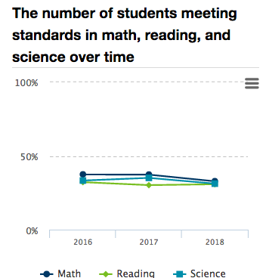
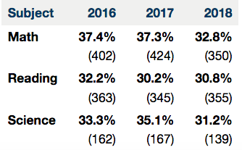
Washington Technology Magnet, MCA Data:

Slide 7
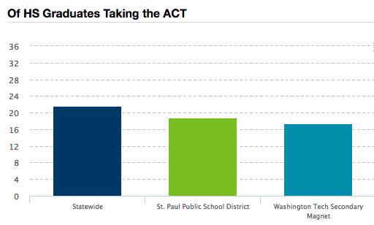
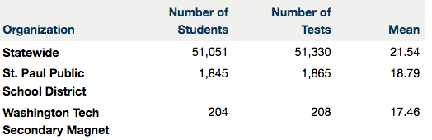
Washington Technology Magnet, Overall ACT Data:

Slide 8
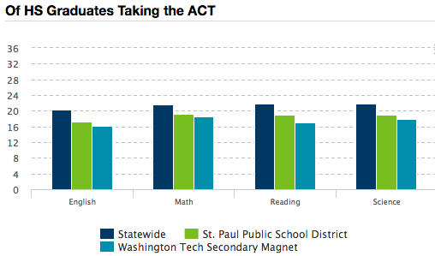

Washington Technology Magnet, ACT Reading Data:

Slide 9
Roth’s College & Career Reading Course Student Profile:
Range of MCA Reading Scores: 1013 – 1051
Range of ACT Composite Scores: 13 – 21
Range of ACT Reading Scores: 11 – 22

Slide 10
MCA ACT ACCUPLACER STANDARDS:
READ CLOSELY
DETERMINE CENTRAL IDEAS & THEMES
SUMMARIZING
UNDERSTANDING RELATIONSHIPS
ANALYZING WORD CHOICE RHETORICALLY
ANALYZING TEXT STRUCTURE
ANALYZING POINT OF VIEW
ANALYZING PURPOSE
ANALYZING ARGUMENTS
ANALYZING MULTIPLE TEXTS

Slide 11
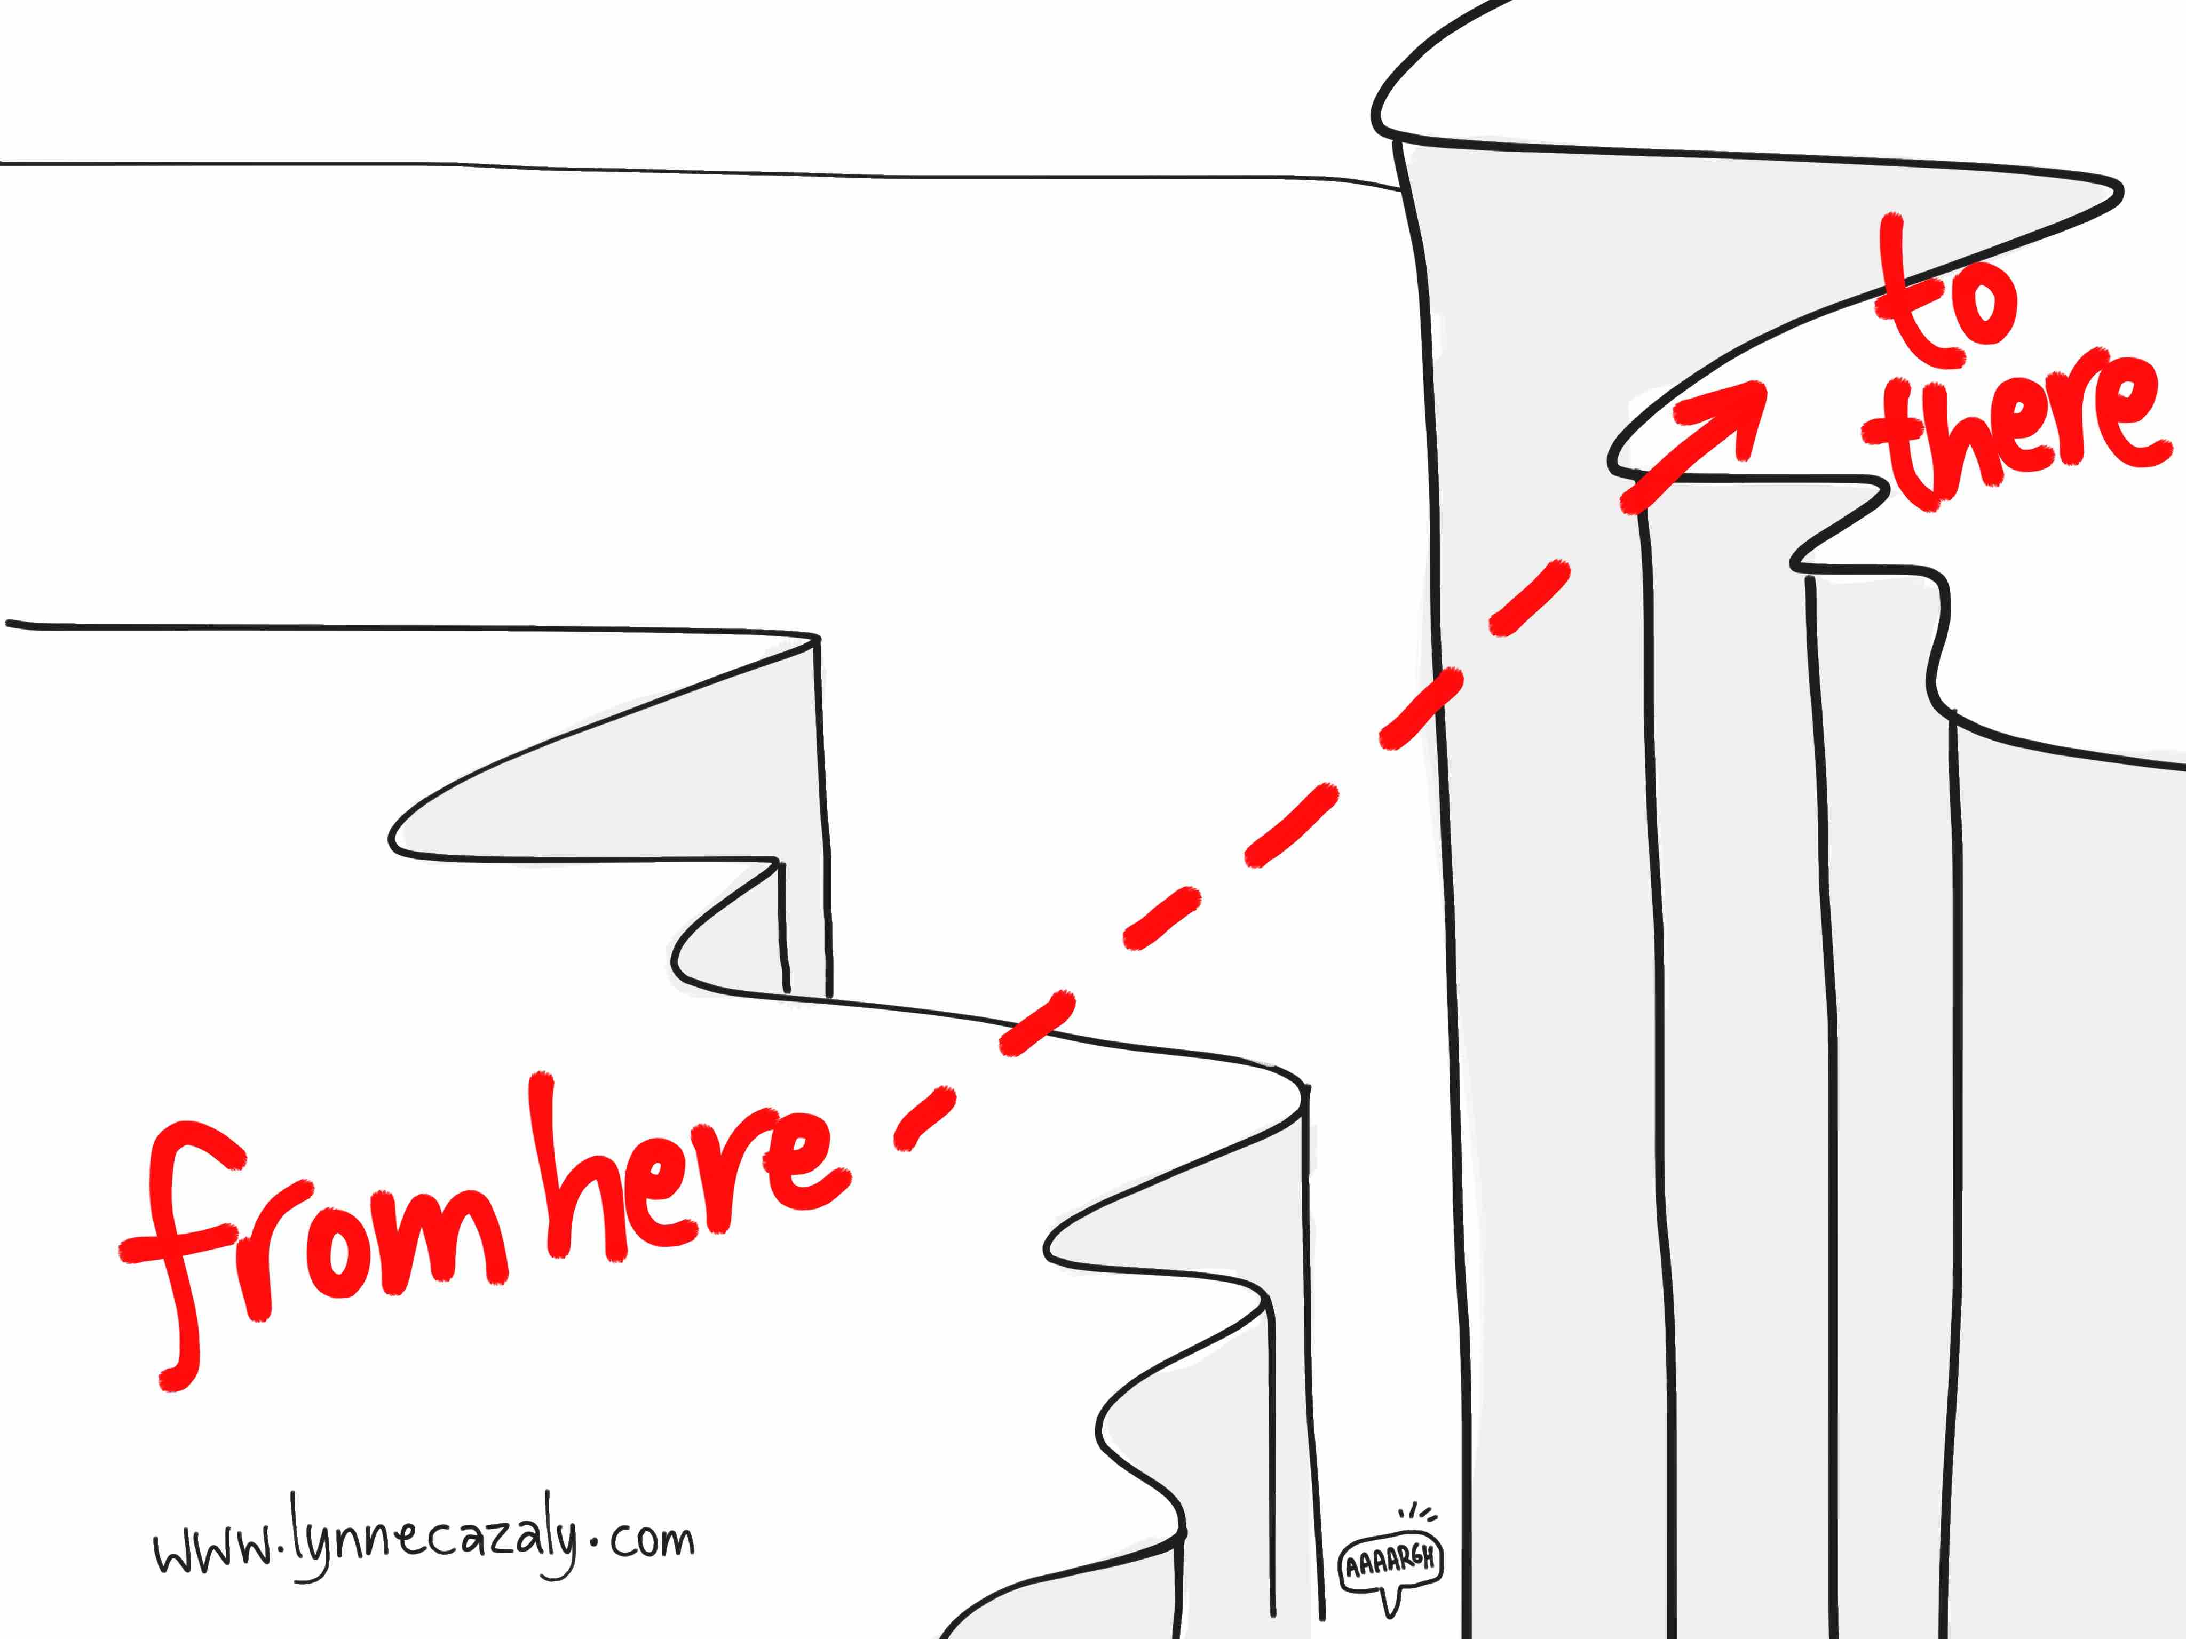
What are my students are listing as
their barriers to reading?
How do we go . . .

Slide 12
What are my students are listing as
their barriers to reading?
Students, tell me what
do you feel is preventing
you from being a good
reader?

Slide 13

I get distracted easily
I don’t know many of the words when I’m reading.
I don’t remember what I read.
I read too quickly.
Much of what I read isn’t interesting to me.

Slide 14
What are my students are listing as
their barriers to reading?
Students, given what you
have experienced in my
classroom, what do you
find helpful?

Slide 15
Reading one sentence at a time and taking a note.
Re-reading
Writing notes while reading.
Reading out loud

Slide 16


Slide 17

Vocabulary
Strategy
Productive reading isn’t enhanced by mystery text,
but rather the reduction of it while reading. It is our
task as educators to reduce the mystery on the page to enhance
and encourage the comprehension of the text.

Slide 18

“Vocabulary growth is not just a question of knowing a word, but knowing the right things about it (nuances of meaning in different contexts). We don’t learn words; we learn semantic networks.” W. Kintsch
Based upon research outcomes, the effective use of visuals can decrease learning time, improve comprehension, enhance retrieval, and increase retention.
Remember the words ------ via the images ->
Bicycle
Feline
Thoroughfare

Slide 19
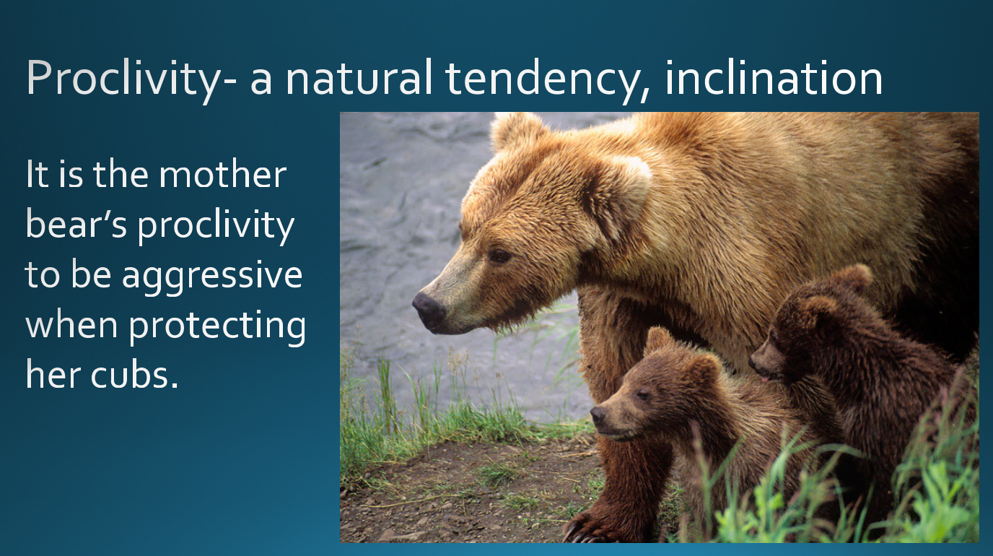
Example from my classroom:
New vocabulary introduction: word, pronunciation, meaning, synonym, example sentence and image

Slide 20
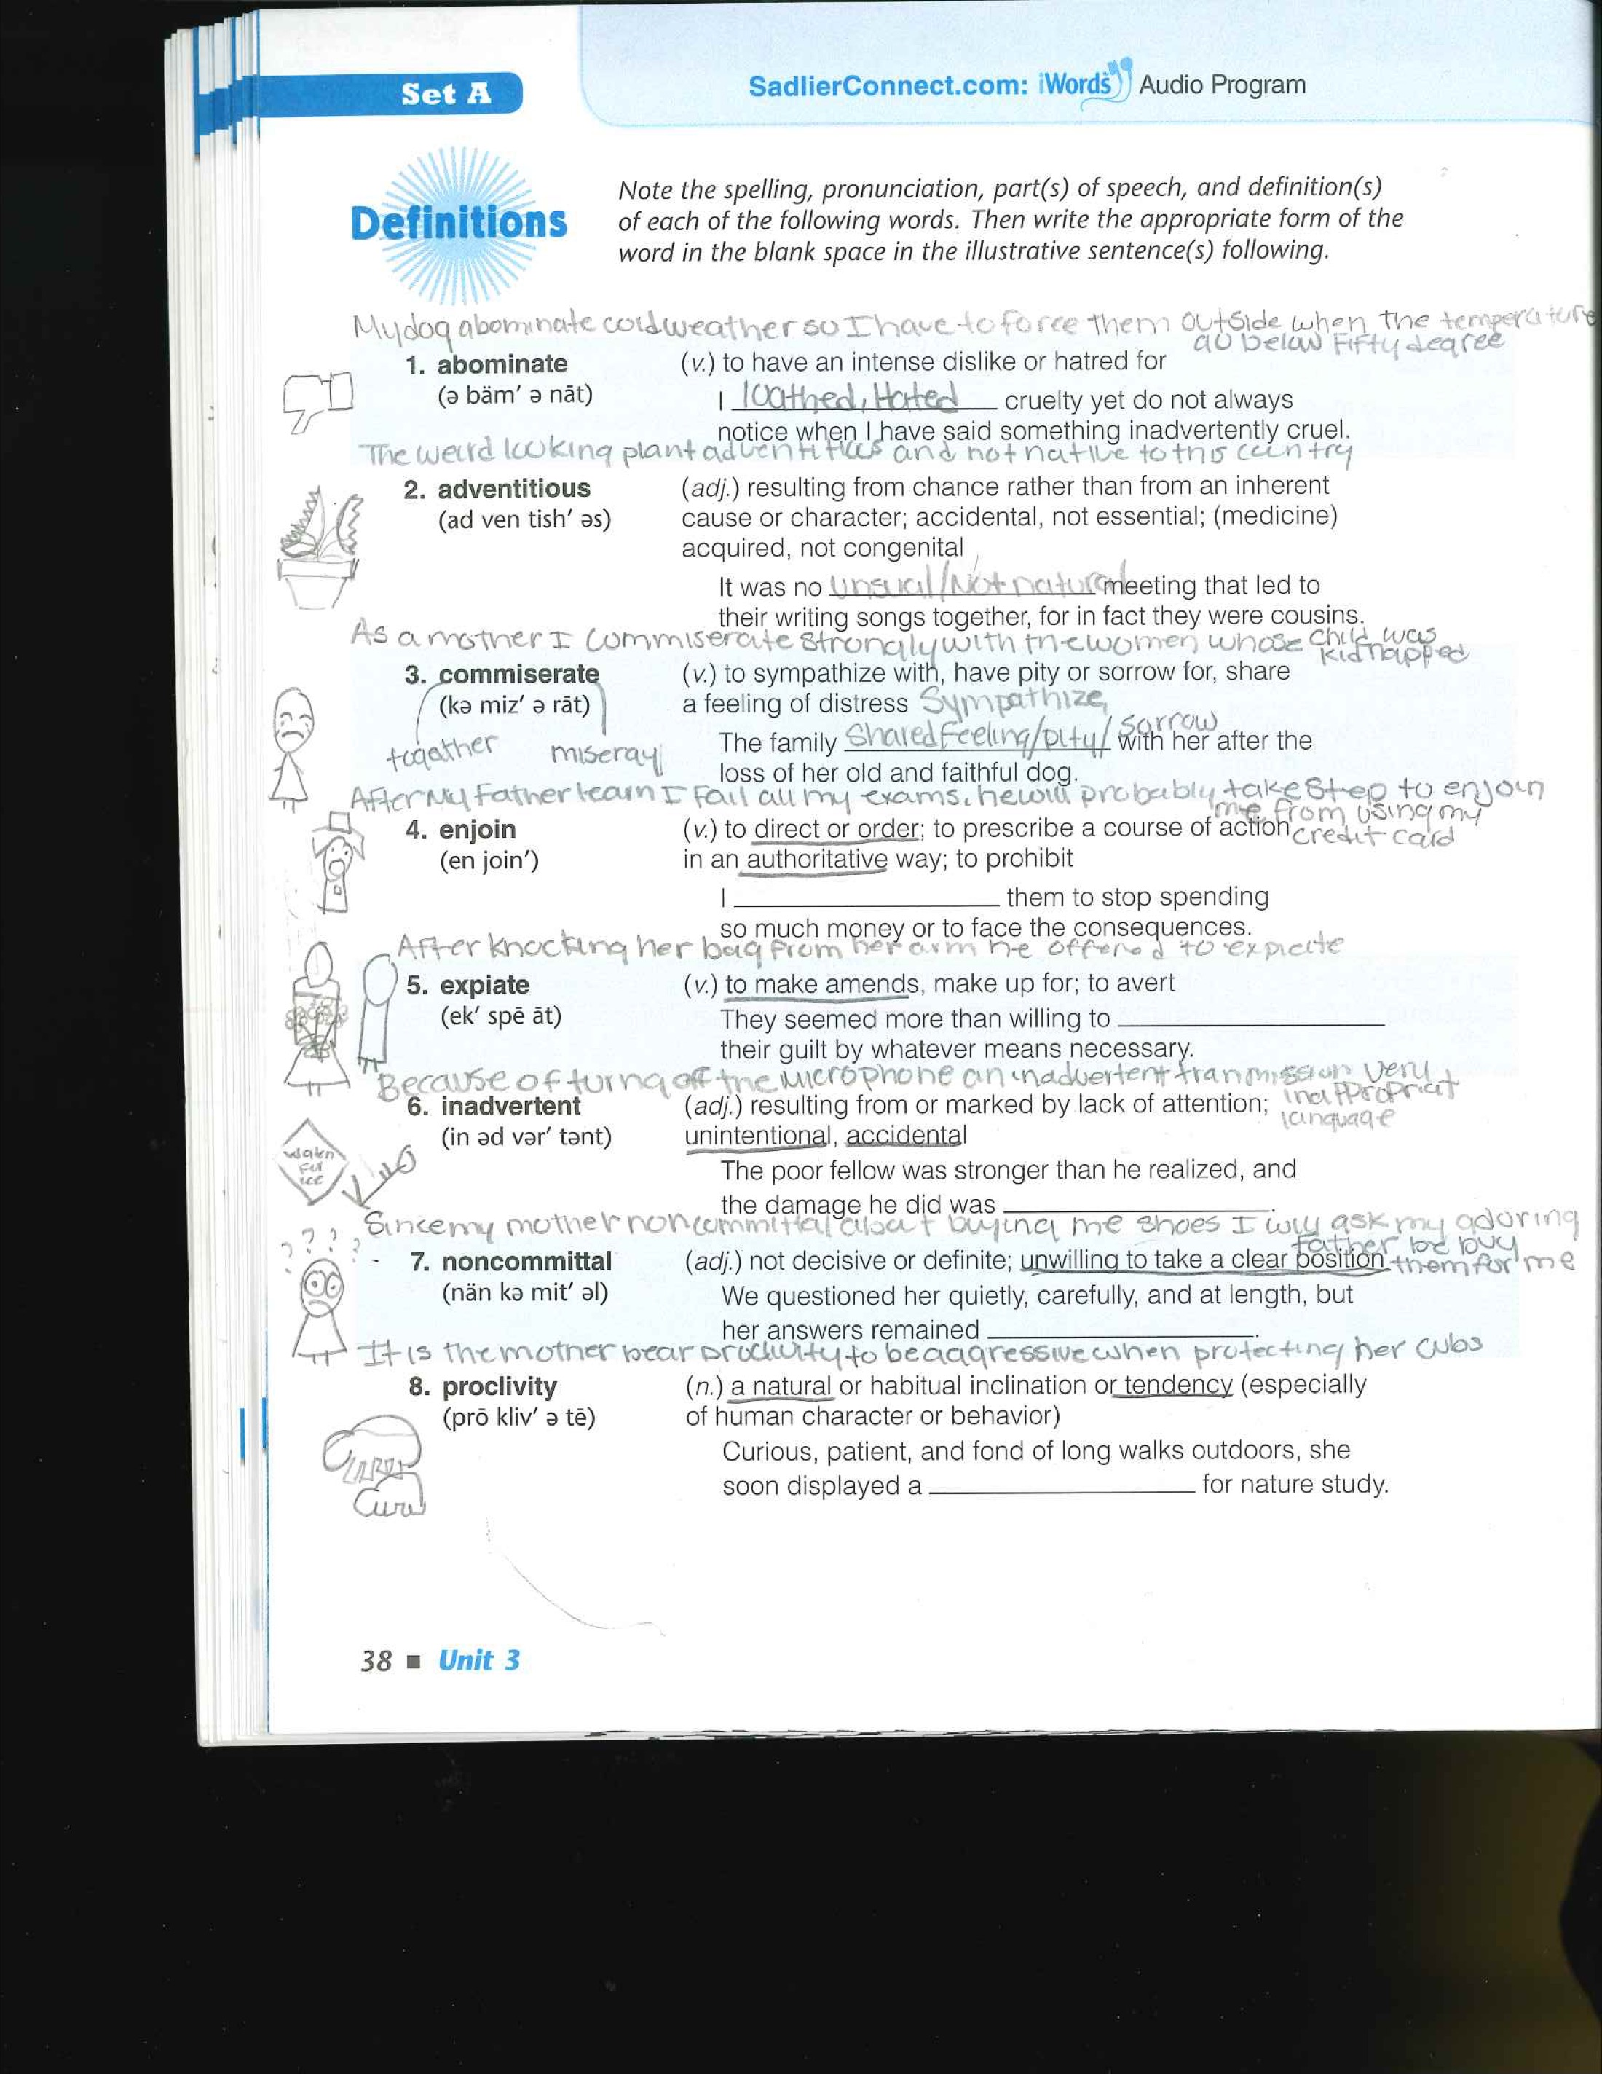
Example from my classroom:
Student generated example sentence
- Application
Student generated image
- Visualization

Slide 21
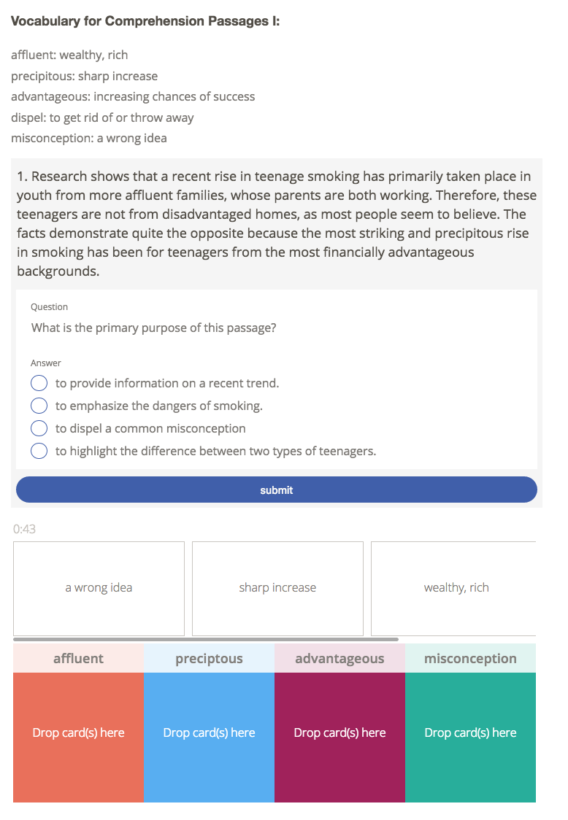
Example from my classroom:
Pre-teaching vocabulary
- Remove mystery in text
Review vocabulary
- Recall

Slide 22
Activities to encourage Vocabulary:
Pre-teach words that are critical for understanding sentence, paragraph, or topic
Create meanings and synonyms with the pre-taught words
Show images of the vocabulary to stimulate the visual memory of the word
Have students create their own sentences with the pre-taught words
Have students go through the text and write the synonym above each important vocabulary word
Group games with vocabulary words, increase intrigue, competiveness in knowing the word
Have students write summaries of the text using the pre-taught vocabulary

Slide 23
Comprehension
Strategy
“…students make progress in comprehension as they travel
through school…the ability to comprehend depends on what the reader brings...knowledge and cognitive strategies. The skilled reader monitors comprehension in accordance with the reader’s criteria of the importance of forming a coherent representation. When recognized, violations of the standard the student will call forth strategies needed to overcome these impediments.” P.David Pearson & D. Liben

Slide 24
What to do if the students do not call forth strategies needed to overcome these impediments?

Slide 25
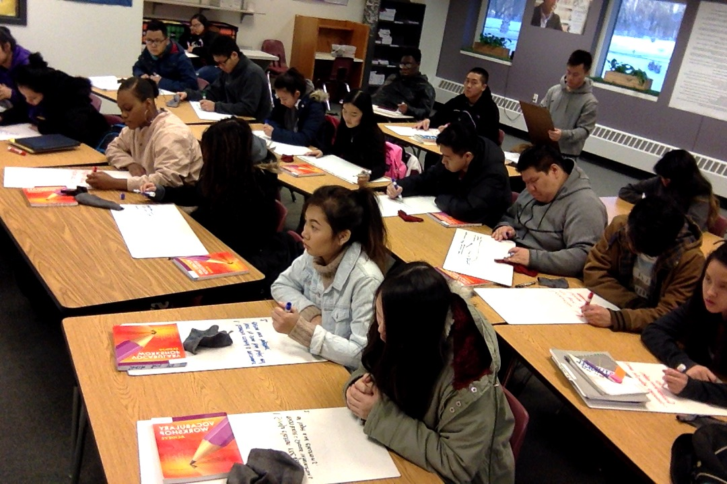
Comprehension
monitoring via
white boards.

Slide 26

Students read on the IPad, and take notes. The notes are then incorporated into either multiple-choice answers or synthesized into an essay.

Slide 27
Why low/no tech white boards or notebooks?
Each student responds to question
The teacher is able to see in real time what is understood or misunderstood by each student
Violations and inconsistencies in comprehension are remediated immediately
Practice is done without time consuming efforts
Fosters independent thought and problem solving

Slide 28
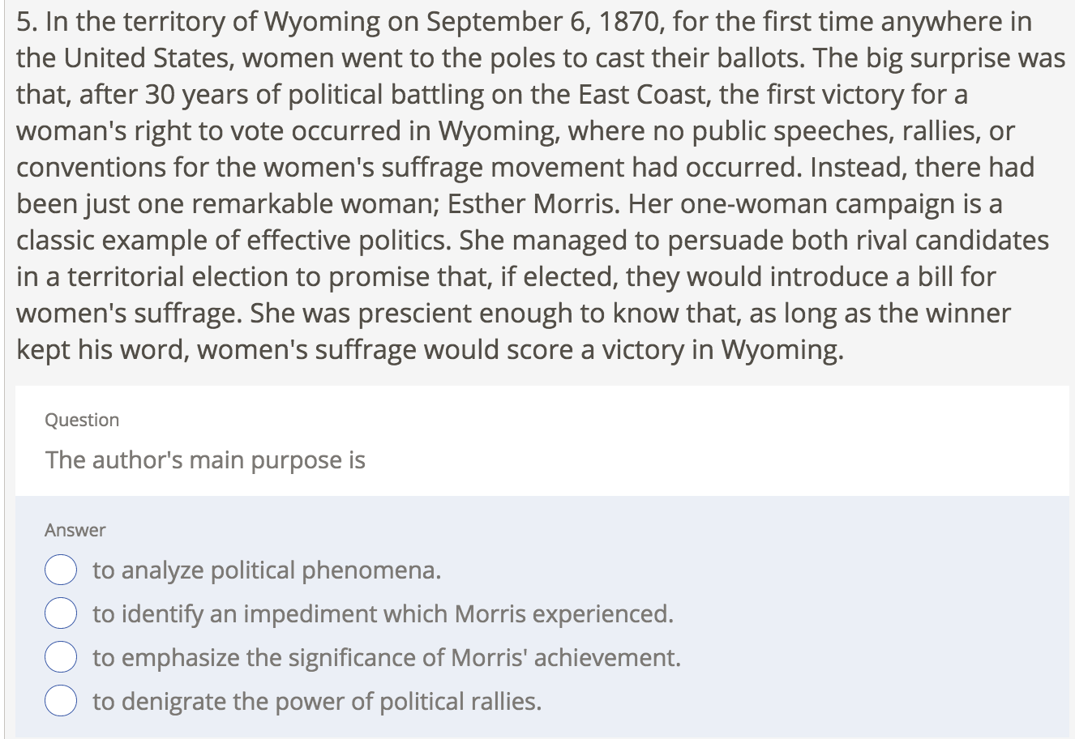
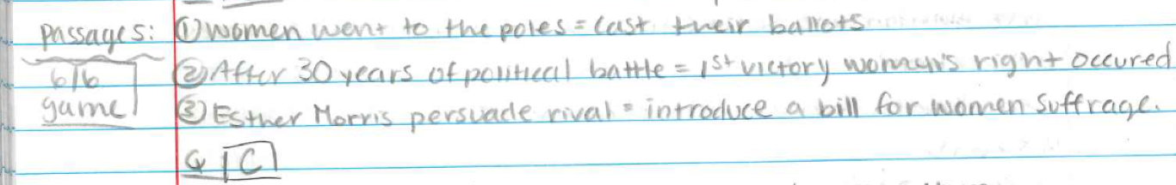
Writing for synthesis and comprehension
If students slow down their reading, reflect after each sentence, and write a brief note, they learn how to synthesize their thoughts, copy less text, and increase their comprehension.
Previously, the students would ”read” through the entire passage, assume they understood the text simply by moving their eyes through the text.

Slide 29
What to do if the reader doesn’t monitor comprehension?
Embedded Questioning is a strategy that interrupts the reader’s reading with a metacognitive probe, allowing the reader the opportunity to recall and reflect.

Slide 30
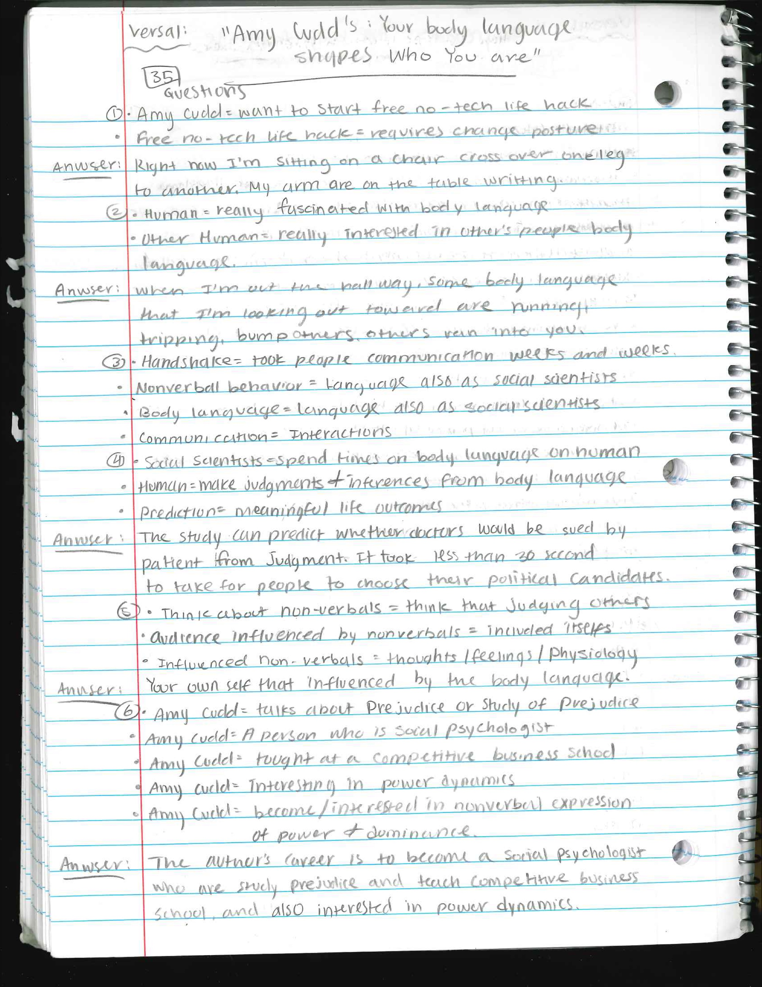
Example from my classroom: TED Talk Transcript with Embedded Questions include vocabulary, literal understanding, and inferential reasoning
1. So I want to start by offering you a free no-tech life hack, and all it requires of you is this: that you change your posture for two minutes. But before I give it away, I want to ask you to right now do a little audit (check) of your body and what you're doing with your body. So how many of you are sort of making yourselves smaller? Maybe you're hunching, crossing your legs, maybe wrapping your ankles. Sometimes we hold onto our arms like this. Sometimes we spread out. I see you. So I want you to pay attention to what you're doing right now. We're going to come back to that in a few minutes, and I'm hoping that if you learn to tweak (change) this a little bit, it could significantly change the way your life unfolds.
Question 1 to answer in Your Notes:
Describe your body posture right now. Are you hunching, crossing your legs, maybe wrapping your ankles?
2. So, we're really fascinated with body language, and we're particularly interested in other people's body language. You know, we're interested in, like, you know — an awkward interaction, or a smile, or a contemptuous glance, or maybe a very awkward wink, or maybe even something like a handshake.
Question 2 to answer in Your Notes:
What body language do you look out for when you are in the school hallways or classrooms?
3. So a handshake, or the lack of a handshake, can have us talking for weeks and weeks and weeks. Even the BBC and The New York Times. So obviously when we think about nonverbal behavior, or body language -- but we call it non-verbals as social scientists -- it's language, so we think about communication. When we think about communication, we think about interactions.
Question 3 to answer in Your Notes:
So what is your body language communicating to me? What's mine communicating to you?

Slide 31
Writing
Strategy
Making use of visualization, we “build” a persuasive
essay from the notes taken from the TED Talks,
novel, or another piece of nonfiction text.

Slide 32
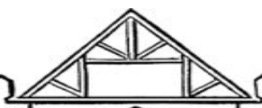
Thesis

Slide 33
Thesis
Hook: Intro

Slide 34
Thesis
Hook: Intro
State Positions

Slide 35

Thesis
Hook: Intro
State Positions
All paragraphs have a
Topic Sentence that is
related to the Thesis
Paragraphs supporting thesis
Paragraphs supporting thesis
Paragraphs supporting thesis
Paragraphs supporting thesis
Paragraphs supporting thesis

Slide 36
Thesis
Hook: Intro
State Positions
All paragraphs have a
Topic Sentence that is
related to the Thesis
Paragraphs supporting thesis
Paragraphs supporting thesis
Paragraphs supporting thesis
Paragraphs supporting thesis
Paragraphs supporting thesis

Slide 37
Thesis
Hook: Intro
State Positions
All paragraphs have a
Topic Sentence that is
related to the Thesis
Paragraphs supporting thesis
Paragraphs supporting thesis
Paragraphs supporting thesis
Paragraphs supporting thesis
Paragraphs supporting thesis

Slide 38
Thesis
Hook: Intro
State Positions
All paragraphs have a
Topic Sentence that is
related to the Thesis
Paragraphs supporting thesis
Paragraphs supporting thesis
Paragraphs supporting thesis
Paragraphs supporting thesis
Paragraphs supporting thesis

Slide 39
Thesis
Hook: Intro
State Positions
All paragraphs have a
Topic Sentence that is
related to the Thesis
Paragraphs supporting thesis
Paragraphs supporting thesis
Paragraphs supporting thesis
Paragraphs supporting thesis
Paragraphs supporting thesis

Slide 40


All supporting details in the
paragraphs support the
paragraph topic sentence.
Thesis
Hook: Intro
State Positions
Paragraphs supporting thesis
Paragraphs supporting thesis
Paragraphs supporting thesis
Paragraphs supporting thesis
Paragraphs supporting thesis
Detail
Detail
Detail
Detail
Detail
Detail
Detail
Detail
Detail
Detail

Slide 41
All supporting details in the
paragraphs support the
paragraph topic sentence.
Thesis
Hook: Intro
State Positions
Paragraphs supporting thesis
Paragraphs supporting thesis
Paragraphs supporting thesis
Paragraphs supporting thesis
Paragraphs supporting thesis
Detail
Detail
Detail
Detail
Detail
Detail
Detail
Detail
Detail
Detail

Slide 42
All supporting details in the
paragraphs support the
paragraph topic sentence.
Thesis
Hook: Intro
State Positions
Paragraphs supporting thesis
Paragraphs supporting thesis
Paragraphs supporting thesis
Paragraphs supporting thesis
Paragraphs supporting thesis
Detail
Detail
Detail
Detail
Detail
Detail
Detail
Detail
Detail
Detail

Slide 43
All supporting details in the
paragraphs support the
paragraph topic sentence.
Thesis
Hook: Intro
State Positions
Paragraphs supporting thesis
Paragraphs supporting thesis
Paragraphs supporting thesis
Paragraphs supporting thesis
Paragraphs supporting thesis
Detail
Detail
Detail
Detail
Detail
Detail
Detail
Detail
Detail
Detail

Slide 44
All supporting details in the
paragraphs support the
paragraph topic sentence.
Thesis
Hook: Intro
State Positions
Paragraphs supporting thesis
Paragraphs supporting thesis
Paragraphs supporting thesis
Paragraphs supporting thesis
Paragraphs supporting thesis
Detail
Detail
Detail
Detail
Detail
Detail
Detail
Detail
Detail
Detail

Slide 45
Thesis
Hook: Intro
State Positions
Paragraphs supporting thesis
Paragraphs supporting thesis
Paragraphs supporting thesis
Paragraphs supporting thesis
Paragraphs supporting thesis
Detail
Detail
Detail
Detail
Detail
Detail
Detail
Detail
Detail
Detail
Conclusion: Restate Thesis in a new way, and supporting arguments

Slide 46
Thesis
Hook: Intro
State Positions
Paragraphs supporting thesis
Paragraphs supporting thesis
Paragraphs supporting thesis
Paragraphs supporting thesis
Paragraphs supporting thesis
Detail
Detail
Detail
Detail
Detail
Detail
Detail
Detail
Detail
Detail
Conclusion: Restate Thesis in a new way, and supporting arguments
Call for action ~ Final plea!

Slide 47
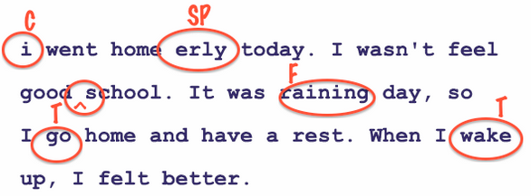
Now … EDIT!!!

Slide 48

Finally!
A finished persuasive essay!
. . . don’t forget your name! : )

Slide 49


Slide 50
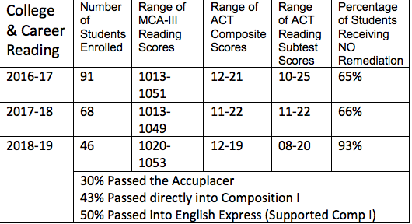

Slide 51
References:
Guthrie, J. T., Wigfield, A., Barbosa, P., Perencevich, K. C., Taboada, A., Davis, M. H., . . . Tonks, S. (2004). Increasing Reading Comprehension and Engagement Through Concept-Oriented Reading Instruction. Journal of Educational Psychology, 96(3), 403-423. Kintsch, W. (1998) Comprehension: A paradigm for cognition. New York: Cambridge University Press;
Magliano et al. “reader’s criteria or general sense of the importance of forming a coherent representation, especially of how different parts of a text are related to one another”: Magliano, J. P., Millis, K. K., Ozuru, Y., & McNamara, D.S.(2007).
McDaniel, M. A., & Einstein, G. O. (1986). Bizarre imagery as an effective memory aid: The importance of distinctiveness. Journal of Experimental Psychology: Learning, Memory, and Cognition, 12(1), 54-65.
Meier, D. (2000). The accelerated learning handbook. NY: McGraw-Hill.
O’Brien, D.G., Stewart, R.A., Moje, E., Why Content Literacy is Difficult to infuse into the Secondary School: Complexities of Curriculum, Pedagogy, and School Culture., Reading Research Quarterly, Vol. 30, No. 3, pp. 442-463.
Pearson, P.D.(1990). Developing Expertise in Reading Comprehension: What Should Be Taught? How Should It Be Taught? Technical Report No. 512, University of Illinois at Urbana-Champaign.
Shanahan, T. (1992). Reading comprehension as a conversation with an author. In M. Pressley, K. R. Harris, & J. T. Guthrie (Eds.), Promoting academic competence and literacy in school (pp. 129–148). San Diego: Academic Press.
Shanahan, T., & Barr, R. (1995). Reading Recovery: An independent evaluation of the effects of an early instructional intervention for at-risk learners. Reading Research Quarterly, 30, 958–996.
Shanahan, T., Shanahan, C., Teaching Disciplinary Literacy to Adolescents: Rethinking Content-Area Literacy, University of Illinois at Chicago, Harvard Educational Review Vol. 78, No. 1, Spring 2008, Copyright © by the President and Fellows of Harvard College
Van Manen, J. M. (2007). The pedagogy of epistolary: Writing to read - reading to write. Unpublished doctoral dissertation, University of Alberta, Edmonton.
Van Oostendorp, H., Goldman, S.R The construction of mental representations during reading (pp. 71-98). Mahwah, NJ: Erlbaum.1998
Woolley, G., Australian Journal of Learning Difficulties Vol. 13 , Iss. 1,2008

Slide 52
“In life, it is never the big battle, the big moment, the big speech, the big election. That does not change things. What changes things is
every day, getting up and rendering
small acts of service and love beyond
that what’s expected
of you or required
of you.” ~ C. Booker
Denise Roth, PhD
denise.roth@spps.org

