Slide 1
Peer to Peer Feedback
Jody Koch
Century College

Slide 2
Why Did I Need This?
Notes:
Want peers to see each other’s work, look critically
More than good job / need better spelling

Slide 3
Using Growth Mindset

Slide 4
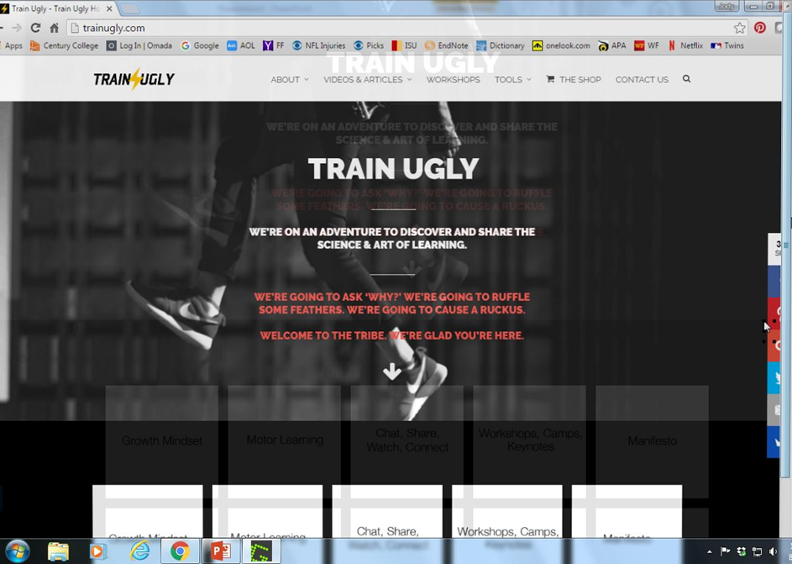
TrainUgly.com
Video: http://trainugly.com/portfolio/peerfeedback/
Types of Praise
Person
  You are so smart!
Process
  Great job, you must have worked hard on this!
Outcome
  You got an A!

Slide 5
Problems with Feedback
Problem 1:
Nearly 50% of all feedback comes from peers
Problem 2:
Over 75% of the feedback people get is about the person or the outcome

Slide 6
Giving Feedback
Specific
Helpful (Process Focused)
Kind
Notes:
Kind does not always mean nice, it can be critical

Slide 7

Draw this butterfly…
Notes:
Trade with a partner, give specific, helpful, and kind feedback

Slide 8
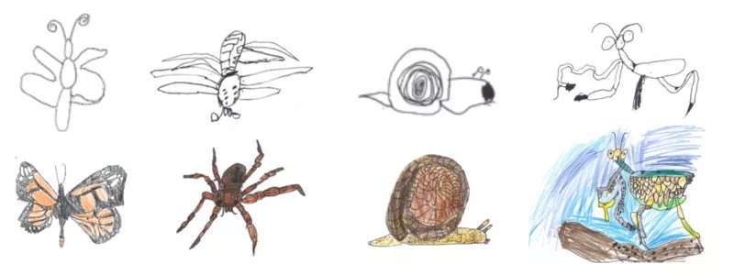
Feedback from Kindergartners
From TrainUgly.com
http://trainugly.com/portfolio/peerfeedback/

Slide 9
Changing My Feedback
Giving appropriate feedback
Most important feedback
Being direct

Slide 10
Extensions
Teach earlier in the semester
Transition to oral feedback

Slide 11
Keep Practicing!

