Slide 1
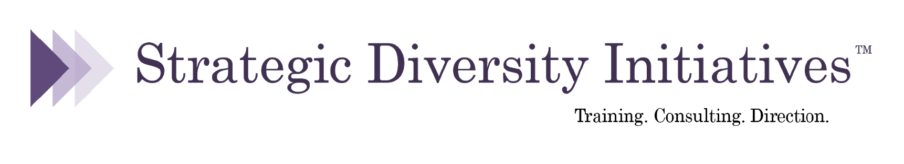
From Allyship to Leadership:
Agency, Accountability, and Emotional Intelligence
Anne Phibbs, PhD
26th Annual MNADE Conference
September 24, 2021

Slide 2
Agenda
Framing:
Understanding & Addressing Microaggressions & Implicit Bias
with Small Group Discussion
From Ally to Leader:
Agency, Accountability, and Emotional Intelligence (EQ)
Scenarios
Small Group Discussion:
Next Steps in my DEI Leadership Development

Slide 3
Micro-inequities or Microaggressions
From Microaggressions: Power, Privilege and Everyday Life
microaggressions.com
This blog seeks to provide a visual representation of the everyday of “microaggressions.” Each event, observation and experience posted is not necessarily particularly striking in and of themselves. Often, they are never meant to hurt - acts done with little conscious awareness of their meanings and effects. Instead, their slow accumulation during a childhood and over a lifetime is in part what defines a marginalized experience, making explanation and communication with someone who does not share this identity particularly difficult.

Slide 4
Examples of Micro-inequities
“A security guard approaches me at an upscale shopping district. I am the only black person sitting in the waiting area. I am waiting for a friend and have been sitting for two minutes. The security guard ignores the throng of people around me, comes to me and asks “What is your business here?” I am 31 & in Chicago & it made me feel like I was…nothing.
Are you a man or a woman?” Repeatedly, everywhere.
I patiently waited after class to ask my professor a question. He then began making sexual comments such as that I made him aware of his age because he could never get with me because I was out of his league. I felt uncomfortable so I left, with my question unanswered. I could not believe that my college professor prioritized his inappropriate comment over my question and ultimately the quality of my education, as I am no longer comfortable going to him for questions.

Slide 5
Examples of Micro-inequities
I had an English teacher who loved to talk, and whenever she’d say anything about race or black culture, she’d turn to me (the only black kid in the room) as if to validate/confirm the statement.
I’m an Asian woman. Whenever there is another Asian woman in my workplace, I inevitably get called by her name, multiple times a day. One day, my white colleague told me “You should realize how hard this is for me and stop caring so much!” after calling me the other Asian girl’s name. Saying “I’m trying!” or “you know it’s not racist” doesn’t help when you’re not trying and it IS racist.
• “What if you accidentally slept with a schizophrenic guy and had a nutter baby?” Said by a girl at work. I have a relative with schizophrenia and have struggled with depression in the past. Made me feel sad, angry and like people are always going to judge you and define you by your mental illness.
When I asked for a promotion my colleagues assert that the graduate students are “afraid of me.” This is not reflected in my teaching reviews or conversations with the many great graduate students in the department. It is enough for them to just say this, with no evidence, to deny promotion. They are straight and white. I am not.

Slide 6
Examples of Micro-inequities
I mention to a co-worker that I grew up in a trailer park, and she says, “But you’re so smart!
My classmate makes a joke about Jews running the media. We all laugh, including me, because they think there are no Jews around to hear it. Made me feel humiliated.
I have no idea how to come out to my colleagues as transgender after I overheard them using transphobic slurs and calling another transgender person an “it.” I’m a young teacher in a rural area. I felt invisible, humiliated, and hopeless.
• Pretty much any time I leave the house in my wheelchair and go to a public place, people feel entitled to come up and ask me the most intrusive personal questions. On a weekly basis, someone asks me: “What’s wrong with you?” People frequently talk over my head to my friends or family members like I am mentally impaired. Many people have told me that they can relate to my disability because they were on crutches for several weeks with a sprained ankle or broken leg. I’m 27 years-old and the comments are always the worst in big cities and on public transportation. Makes me feel anxious, frustrated, angry, and sad.

Slide 7
Tips for Taking Action
5 questions to ask yourself when weighing the consequences of responding to a microaggression (and other disrespectful behavior):
If I respond, could my physical safety be in danger?
If I respond, will the person become defensive and will this lead to an argument?
If I respond, how will this affect my relationship with this person (e.g., co-worker, family member, etc.)
If I don’t respond, will I regret not saying something?
If I don’t respond, does that convey that I accept the behavior or statement?
“How to Respond to Microaggressions,” Hahna Yoon, New York Times, 3/3/20

Slide 8
Tips for Taking Action
Suggestions from diversity consultant Dr. Diane Goodman:
Ask for more clarification: “Could you say more about what you mean by that?” “How have you come to think that?”
Separate intent from impact: “I know you didn’t realize this, but when you __________ (comment/behavior), it was hurtful/offensive because___________. Instead you could___________ (different language or behavior.)”
Share your own process: “I noticed that you ___________ (comment/behavior). I used to do/say that, too, but then I learned____________.”
“How to Respond to Microaggressions,” Hahna Yoon, New York Times, 3/3/20

Slide 9
“Unexamined bias is a form of stereotyping that is often unintentional, automatic, and outside of our awareness. Often contradicting to our conscious beliefs. Also called subtle or implicit bias. Framing it specifically as “unexamined” puts onus for change on the person who harbors or acts on bias, holding them accountable.”
Implicit/Unconscious/Unexamined Bias
Center for Institutional Change, University of Washington

Slide 10
TEDx Basel:
Are You Biased? I am
(August, 2016)
Kristen Pressner
Global Head Human Resources,
Roche Diagnostics

Slide 11
Resources
Project Implicit
Kirwan Institute for the Study of Race and Ethnicity, Ohio State University
Project Implicit is a non-profit organization and international collaboration between researchers who are interested in implicit social cognition - thoughts and feelings outside of conscious awareness and control. The goal of the organization is to educate the public about hidden biases and to provide a “virtual laboratory” for collecting data on the Internet.
implicit.harvard.edu/implicit/research
Kirwan Institute for the Study of The
kirwaninstitute.osu.edu
Haas Institute for a Fair and Inclusive Society
haasinstitute.berkeley.edu
Perception Institute - perception.org
Biased: Uncovering the Hidden Prejudice That Shapes What We See, Think, and Do, Jennifer L. Eberhardt, PhD, Viking, 2019

Slide 12
Research on Implicit Bias
“Are Emily and Greg More Employable than Lakisha and Jamal? A Field Experiment on Labor Market Discrimination,” (Bertrand & Mullainathan, American Economic Review, 2004)
Stereotypical “white” vs. “black” names (in a U.S. context); otherwise identical resumes
Resume with “white” names had 50% more callbacks
Many other studies, including those dealing with housing, health care, online sales, and perceptions of risk and safety, have demonstrated that people of all racial identities demonstrate a pro-white and anti-black bias.

Slide 13
Research from Nextion, Consulting Firm
60 partners from 22 law firms received copies of a memo with 22 errors (minor spelling or grammar errors, technical writing errors, errors in fact, and errors in analysis of the facts).
Half told memo written by an African-American man and half told writer was a white man (both Thomas Meyer).
The reviewers gave the memo supposedly written by a white man a rating of 4.1 out of 5, while they gave the memo supposedly written by a black man a rating of 3.2 out of 5. The white Thomas Meyer was praised for his potential and good analytical skills, while the black Thomas Meyer was criticized as average at best and needing a lot of work.
Reviewers found an average of 2.9 out of 7 spelling and grammar errors in the memo by the white Thomas Meyer and 5.8 out of seven errors in the memo by the African-American Thomas Meyer.

Slide 14
Research on Implicit Bias
“Science faculty’s subtle gender biases favor male students,” (Moss-Racusin, Dovidio, Brescoll, Graham & Handelsman, PNAS, 2012)
Male & female science professors asked to review apps for lab manager position
Both male & female professors rated male applicants more competent, more hireable, more suitable for mentoring, and offered males higher salaries
As with race-focused research, people of all gender identities demonstrate a pro-male and anti-female bias

Slide 15
Research on Implicit Bias
“Pride and Prejudice: Employment Discrimination against Openly Gay Men in the United States,” Tilcsik, American Journal of Sociology, 2011.
Study revealed bias against openly gay candidates
“Attitudes towards individuals with disabilities as measured by the Implicit Association Test: A literature review,” (Wilson and Scior, 2013)
17 articles were reviewed. Across all studies, implicit bias was evident against people with disabilities.
Notes:
Resumes identical except for which campus organization was listed; resumes sent for 5 different occupations in 7 states
Overall, applicants who listed a gay campus organization vs. a more generic campus organization had 40% fewer callbacks
This demonstrates bias against openly gay candidates

Slide 16
Small Group Discussion: Microaggressions & Implicit Bias
• Have you ever witnessed or experienced a microaggression/ micro-inequity? What happened? How did you react?
• Do you think you’ve ever committed a microaggression/. micro-inequity? What happened? How did others react?
• Do you think implicit bias affects decisions made by your institution/ organization?
• Does your institution/organization talk openly about microaggressions/micro-inequities and implicit bias?

Slide 17
From Ally to Leader:
Agency, Accountability, and Emotional Intelligence (EQ)

Slide 18
Our work – and our workplaces – are changing, consider:
• the unexpected “social experiment” that is the coronavirus pandemic, with working from home & virtual meetings – and also increased racial & class disparities around healthcare, health outcomes, and job security; additional responsibilities for childcare, schooling, and care of family members falling disproportionately to women
• the racial reckoning/uprising that followed the murder of George Floyd, including a renewed call for antiracist action in all aspects of society
• increasing LGBTQ – and nonbinary – identification, particularly among those in Generation Z and millennials; and increasing attention to pronouns and gendered language
• an increase in conversations around mental health, mental illness, and self care (e.g., among elite athletes like Simone Biles & Naomi Osaka)

Slide 19
And our colleagues, clients, students, and community members are changing
• in the U.S., the majority of our children are Black, Indigenous, and/or people of color (BIPOC); this will be true for all Americans by 2045 – yet many of our local, state, and national organizations and institutions remain predominantly white, especially at the leadership level
• organizations are being pushed – by current and potential employees, by donors, by foundations, by community members – to reflect the communities they serve and to function from values of equity and inclusion
• and institutions are rushing to catch up; to reflect this new reality – they are auditing and assessing themselves, creating committees and strategic plans, and hiring staff – all focused on diversity, equity, and inclusion (DEI)
• so leaders & institutions are being held accountable for this challenging work

Slide 20
How is diversity, equity, and inclusion (DEI) work challenging?
• having limited time and limited resources (money, staffing, etc.)
• size and complexity of changes we want to make (e.g., policies)
• managing expectations of multiple stakeholders; dealing with pushback
• navigating internal and external barriers (e.g., “ways of doing things” in higher education; dealing with systemic racism, etc.)
• setting personal boundaries in order to avoid burnout
• managing bias, conflict, and challenging personalities on our teams
• building sustainability into our efforts and developing future leaders

Slide 21
DEI Leadership:
Encouraging Agency;
Expecting Accountability;
Developing Emotional Intelligence

Slide 22
Encouraging Agency
• Creating a workplace/classroom that is open, inclusive, and equitable – that is free from bullying, microaggressions, and bias – is the responsibility of every person involved in an organization/institution. It is the responsibility of board members and trustees, of students, faculty, administrators, and of people in all job classifications and pay grades.
• Making substantive changes around diversity, equity, and inclusion requires identifying – and developing – DEI leaders in every part of the organization. It’s not about a top down vs. a grassroots approach. It’s about educating and empowering everyone to see equity and inclusion as integral to their organizational role.
• Catherine Mattice, President of Civility Partners, suggests that “bystanders” to bullying and incivility should be renamed “reinforcers.” Organizations must ask: how are we allowing our leaders, managers, staff, volunteers, board members, etc. to reinforce microaggressions, bias, and inequity?
.

Slide 23
Expecting Accountability
From “Brene on Shame and Accountability,” Unlocking Us Podcast, Brene Brown, July 1, 2020
Accountability is not comfortable…being held accountable [for racism] and feeling shame is not the same thing as being shamed.
“Shame is the intensely painful feeling or experience of believing that we are flawed and therefore unworthy of love, belonging, and connection.” Guilt is “I did something bad.” Shame is “I am bad.”
During every one of the many times that I have been held accountable for not recognizing my own privilege, or centering my story or my experience, every time, I’ve experienced shame. Not guilt. I didn’t feel like, “Oh. I did something bad,” or “These actions are not aligning with my values.” My response, first response, has always been full-on shame.
.

Slide 24
Expecting Accountability
From “Brene on Shame and Accountability,” Unlocking Us Podcast, Brene Brown, July 1, 2020
And it’s our responsibility for experiencing and regulating our own emotions. It’s my job to regulate my emotion, move through shame in a productive way, without defensiveness, without doubling down, without rationalizing…
…we solve the problem of accountability with action…It’s “What am I going to do differently? How am I going to show up differently? What choices, different choices, am I going to make moving forward? How am I going to think about the language that I’m using? And how am I going to think about how I’m showing up?” Change, action, is probably the best cure for the shame we experience around accountability.

Slide 25
Have you ever...
• met someone who was interesting, but didn’t know when to stop talking & never asked you a single question?
• worked with someone whose anger was always so close to the surface, you worried they might “go off” at any minute?
• been around someone who seemed to have very low self-esteem, such that they never stood up for themselves?
• worked with someone who
- took credit for other’s work
- never apologized, even when wrong
- acted like a bully
• interacted with someone who
- made mountains out of mole hills
- panicked at the slightest problem
- had a negative attitude towards just about everything?

Slide 26
Developing Emotional Intelligence (EQ)
Emotional Intelligence (EQ or EI) is a term created by two researchers – Peter Salavoy and John Mayer – and popularized by Dan Goleman.
Daniel Goleman is a psychologist and was a New York Times reporter focusing on the brain and behavioral sciences. His 1995 book, Emotional Intelligence, was on The New York Times bestseller list for a year-and-a-half, with more than 5,000,000 copies in print worldwide in 40 languages.
They define EQ as the ability to:
• Recognize, understand and manage our own emotions
• Recognize, understand and influence the emotions of others

Slide 27
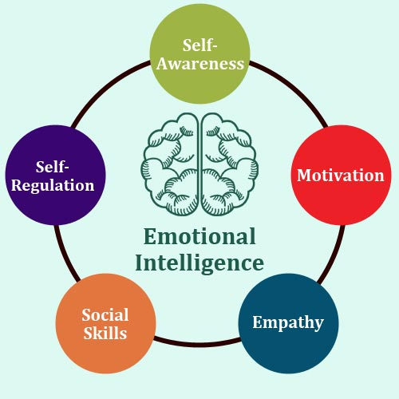
Emotional Intelligence (EQ)

Slide 28
From Permission to Feel : Unlocking the Power of Emotions to Help Our Kids, Ourselves, and Our Society Thrive, 2019, by Dr. Mark Brackett, Director, Yale Center for Emotional Intelligence. Brackett identifies five skills necessary for becoming an “emotion scientist”
• Recognize our own emotions and those of others, not just in the things we think, feel, and say but in facial expressions, body language, vocal tones and other nonverbal signals
•Understand those feelings and determine their source - what experiences actually caused them – and then see how they’ve influenced our behaviors
• Label emotions with a nuanced vocabulary
•Express our feelings in accordance with cultural norms and social contexts in a way that tries to inform and invites empathy from the listener
• Regulate emotions, rather than let them regulate us, by finding practical strategies for dealing with what we and others feel

Slide 29
Brene Brown on Empathy
(RSA, 2013)
Brene Brown on Blame
(RSA, 2015)
The mission of the RSA (Royal Society for the encouragement of Arts, Manufactures and Commerce) is to enrich society through ideas and action.

Slide 30
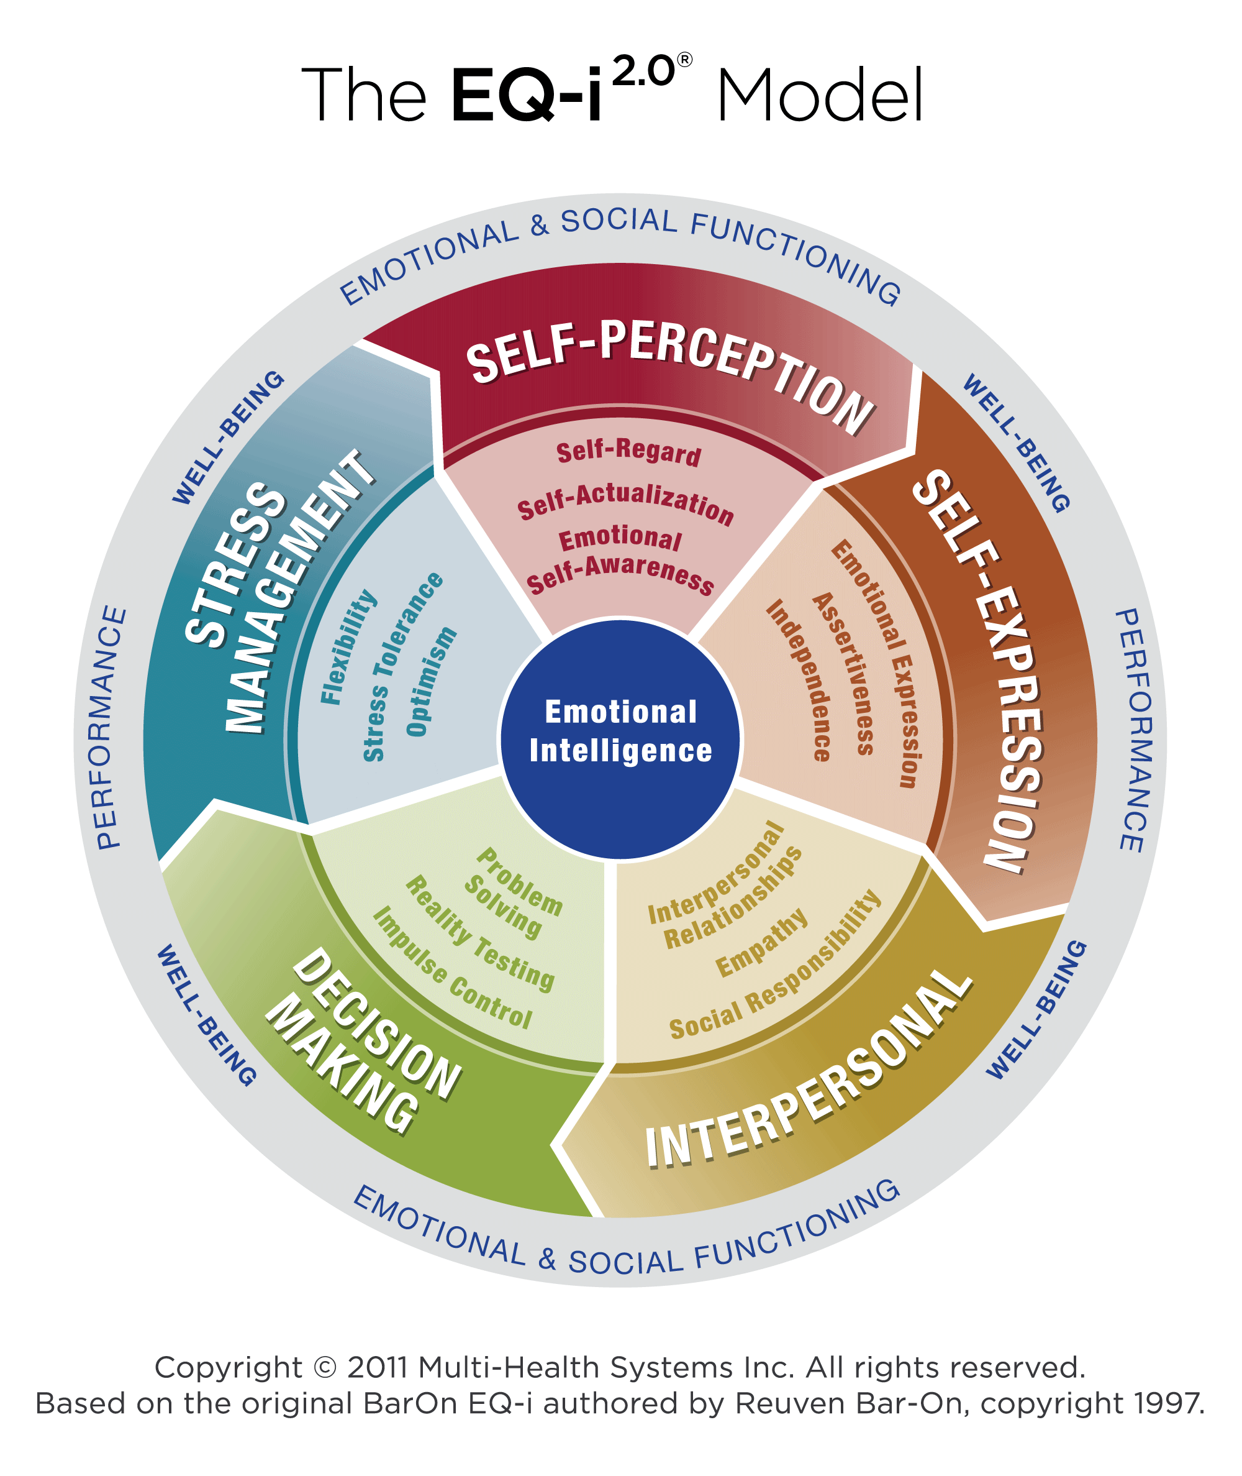
Emotional Intelligence (EQ)

Slide 31
Emotional Intelligence (EQ)
Total EI
Self Expression
Interpersonal
Decision Making
Stress Management
Emotional Expression
Assertiveness
Independence
Interpersonal Relationships
Empathy
Social Responsibility
Problem Solving
Reality Testing
Impulse Control
Flexibility
Stress Tolerance
Optimism
Self Perception
Self Regard
Self Actualization
Emotional Self Awareness

Slide 32
Brene Brown: The Power of Vulnerability, 2012
In this TED Talk, Brown talks about people who are “whole-hearted” – who have a sense of worthiness and love & belonging. In her research, she found whole-hearted people shared these traits:
• Courage - to be imperfect
• Compassion – towards themselves and toward others
• Connection – willingness to be authentic & real, not perfect
• Vulnerability – fully embracing our own and others’
• As we consider what it means to use emotional intelligence (EQ) in DEI work, consider these traits. Do you think they are useful to your DEI work? Do they show up in your work – if so, how? If not, why not?

Slide 33
Thoughts on EQ, Agency, Accountability, and Leadership
• DEI work is never just intellectual; it involves emotions, identity, and relationships. For this reason, having the best analysis or being the smartest person in the room won’t be enough for leading people in DEI efforts.
• This work is about challenging – and changing – oppressive structures and systems that have been in place for centuries. DEI leaders will always deal with pushback and resistance. Leaders model how to find agency and power – and how to think and act strategically – even in the face of racism, misogyny, ableism, homo-bi-transphobia, xenophobia, ageism, elitism, islamophobia & anti-Semitism, etc.
• DEI work will often be slow, overwhelming, and traumatic. A DEI leader models how to take care of themselves by being realistic and setting limits, respecting their own – and others’ – boundaries, and leaving room for emotional work.
• DEI leaders model how to hold each other accountable; leaders admit their own biases and mistakes; leaders make amends; and leaders model how to do better. DEI leaders work to acknowledge and recognize their own privilege and actively use it in the service of equity and inclusion.

Slide 34
Scenarios

Slide 35
Small Group Discussion:
Next Steps in my Leadership Development
• What part of today’s workshop has resonated for you? Why do you think that is?
• Consider concrete next steps you can take in your own development as a leader on diversity, equity, and inclusion (DEI).
What can you do in one week? next month? the coming year?
How can you hold yourself accountable for taking these next steps?

Slide 36

Thank you!
Anne Phibbs
anne.phibbs@strategicdi.com
strategicdi.com

