Slide 1

Overcoming the Math Barrier: The Case for Math Pathways
Sarah Bustrom, LSC
Jenny Joa, HTC
Katie Smieja, SCTCC

Slide 2

Math completion is a barrier to college completion.
Over 60% of the students entering liberal arts and community colleges in the United States enroll in developmental math courses, and an astounding 70% of them do not succeed at these courses (Bailey, Jeong, & Cho, 2010).

Slide 3
Math completion is a barrier to college completion.
“Entry-level college math courses—often referred to as gateway courses—and developmental math courses are considered to be the biggest barriers to college completion, not only among policymakers and institutional leaders, but also among the leadership of the American Mathematical Association of Two-Year Colleges (AMATYC), the American Mathematical Society (AMS), the American Statistical Association (ASA), the Mathematical Association of America (MAA), and the Society for Industrial and Applied Mathematics (SIAM).”
https://dcmathpathways.org/sites/default/files/resources/2017-05/Momentum%20for%20Improving%20Undergraduate%20Mathematics_%20Progress%20from%20State%20Mathematics%20Task%20Forces_2017.pdf

Slide 4
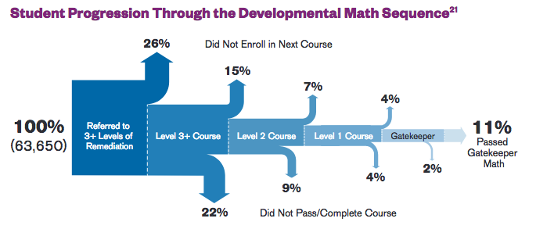
Source: “What We Know about Developmental Education Outcomes,” CCRC, Teachers College, Columbia University, January 2014, 5, http://ccrc.tc.columbia.edu/media/k2/attachments/what-we-know-about-developmental-education-outcomes.pdf
Notes:
N = 63650, CCRC analysis involving 57 community colleges, note all percentages are out of the starting amount, not the current course
Not only are students not completing, but we're losing them completely.

Slide 5
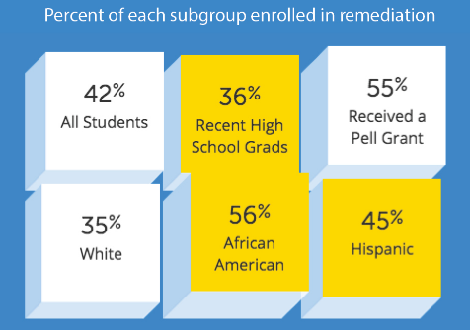
https://dcmathpathways.org/sites/default/files/2016-08/Corequisite%20Remediation_%20Spanning%20the%20Divide.pdf

Slide 6
The Algebra-for-All Problem
Arbitrary barriers to program entry, degree completion
Misconceptions about content
Critical thinking and problem solving through abstract mathematics
Equity concerns: disparities in success rates by race and ethnicity
Fear of transfer acceptance
“College-Ready” vs. “College-Algebra-Ready”
Mismatched content with student goals: the mathematics of physics and engineering for all students
Narrow definition of rigor
Notes:
Math to weed out students. Success in math is a pedigree that confirms or denies access to educational privilege.
Honestly, for students who are not Calculus bound, College Algebra is not a good way to enhance their Quantitative Literacy or instill some appreciation of what mathematics has to offer.
College Algebra may contain some critical thinking and problem-solving, but it isn’t the main focus. Highly procedural. Not useful for many students.
Be clear –this doesn’t mean we think students can’t learn algebra. They just don’t have to.
Math isn’t just for physics and engineers, but that’s the only mathematics we ever teach!
Placement is often based on algebra performance; dev ed courses often algebra based

Slide 7
College Algebra is Calculus Prep
Only 10% of students who take College Algebra ever enroll in a Calculus course.
The Mathematical Association of America (MAA), American Math Association for Two-Year Colleges (AMATYC), and other national math associations agree that College Algebra is not an appropriate gateway math course for students not pursing Calculus.
Notes:
- College Algebra was introduced to the US student population after WWII as a stepping stone to Calculus. Aside from the few select majors who need Calculus, the majority of students who are currently required to take College Algebra will use very little of what they learn in those classes, beyond basic algebra, in their future coursework, careers, or daily lives.

Slide 8
The status quo is unacceptable.

Slide 9
Dana Center Math Pathways (DCMP):
Four Guiding Principles
2. Students complete their first college-level mathematics requirement in their first year of college.
3. Strategies to support students as learners are integrated into courses and are aligned across the institution.
4. Instruction incorporates evidence-based curriculum and pedagogy.
1. All students, regardless of college readiness, enter directly into mathematics pathways aligned to their programs of study.

Slide 10



Relevant Mathematics Aligned to Field of Study

Slide 11
Relevant Mathematics Aligned to Field of Study
Calculus Preparation
College Algebra
Precalculus
Trigonometry
Statistics
Statistical Reasoning
Inferential Statistics
Quantitative Reasoning
Program-Specific Mathematics
Math for teachers
Finite Math
Technical Math

Slide 12
Developing Numeracy:
Quantitative Reasoning
Mathematical maturity
Confident to approach and persist through quantitative problems in new situations
Identify resources, knowledge, and solution paths needed to solve problems
Evaluate the reasonableness of quantitative information
Read, interpret, critique, and question data and quantitative claims
Relevant, authentic applications
Notes:
QR is the ultimate culturally responsive math course. Opportunity to explore social justice, experience the math that shapes the world

Slide 13
Quantitative Reasoning is a better option for many degrees.
Applications of mathematical thinking
Numeracy
Experience authentic, messy problems
Finally learn something new and relevant
Align content to students' mathematical needs
Build math identity and math agency
Discovery learning
Productive struggle
Develop better students, employees, and citizens of the 21st century
Nearly all careers will require students to reason with quantitative information
Notes:
Students must have tools needed to interpret statistical research (public health, economy, crime rates, diet/food recommendations, etc.) for personal and professional decision making.
To use math in real life you have to be able to deal with problems that are not packaged all neat and tidy: with all of the pertinent info, and nothing extra, with all the numbers working out nicely. So, QR will deal a lot with critical thinking, problem solving, problems that aren’t always modeled, and answers which don’t always look pretty.
Finance, Budgeting, Home Repairs (calculations and costs), Problem Solving. Making informed medical decisions, understanding public policy issues,
Synthesis of several skills used in real-life applications: Ability to solve multi-step application problems, where you already have the ‘basic skill’ knowledge in your tool-box, now you need to determine what to do, does it seem reasonable, can I communicate it to another person, etc.
- Discovery Learning. Fostering critical thinking and problems solving skills, make connections, and explain. Learn persistence, Grit, that you can’t give up every time you encounter something difficult. And, you can’t learn math by just having someone show you.
Active learning, working in teams, emphasis on modeling and statistics
Culturally responsive, opportunity for social justice, relevant

Slide 14
Employers in all fields need students to leave college with the skills to be effective, productive citizens of the 21st century.
work effectively in groups
solve problems and figure things out without always being told what to do
utilize resources and technology appropriately
persist and persevere through difficult problems
read and write about quantitative situations and solutions
critically analyze and interpret data and quantitative information
apply reasoning skills to quantitative situations without fear
Notes:
Note that algebraic manipulation, solving abstract equations, and graphing functions without a calculator did not make the list.

Slide 15
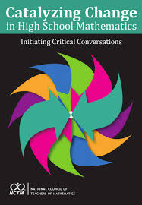
Broadening Our View on Mathematics
Students should experience mathematics to understand and critique the world: the power to understand how things work, to actively critique and create.​
Experience wonder, joy, and beauty of mathematics: see triumphs of human ingenuity, beauty of reasoning and thrill of understanding

Slide 16
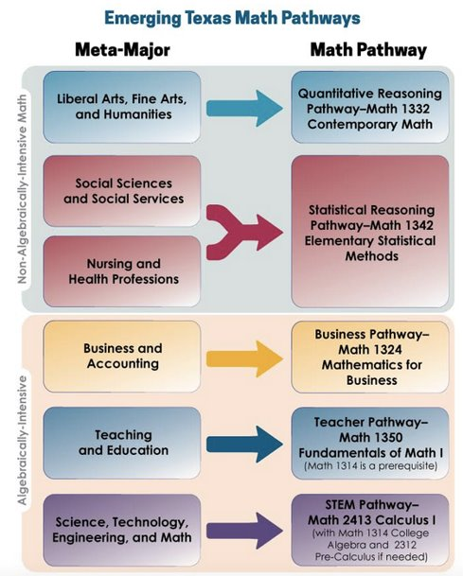
https://dcmathpathways.org/sites/default/files/2016-08/Emerging%20Texas%20Math%20Pathways.jpg

Slide 17
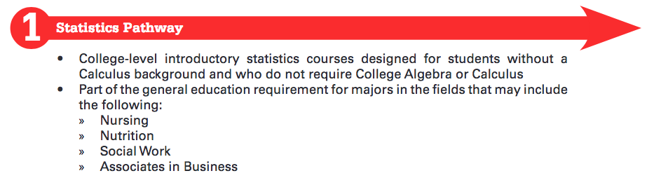
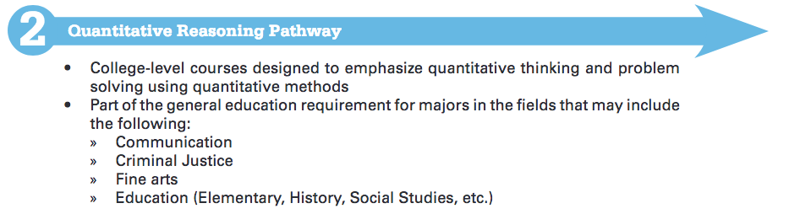
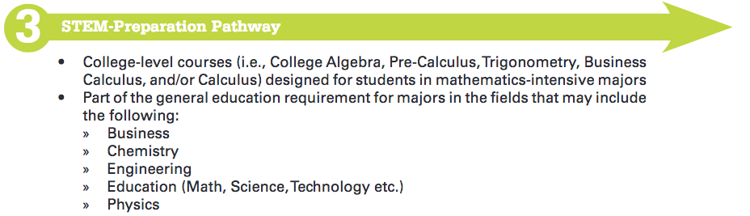
Ohio Math Pathways
https://www.ohiohighered.org/sites/ohiohighered.org/files/uploads/math/OMI-mathematics-pathways_121415.pdf

Slide 18
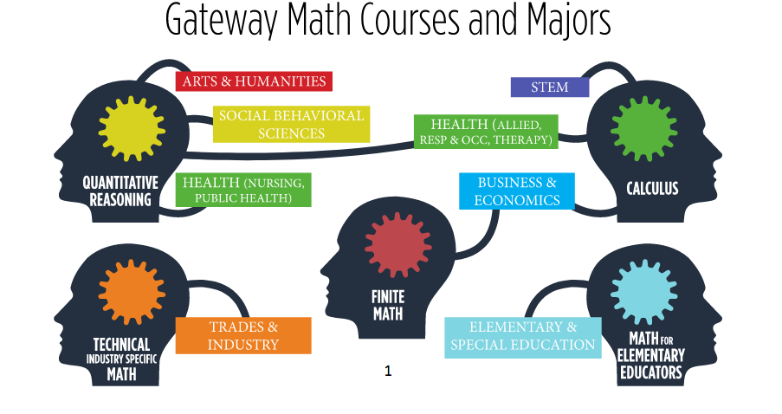
Ivy Tech Math Pathways - Indiana

Slide 19
Minnesota's Mathematics Requirements by Major

Slide 20
Acceleration and Support Structures

Slide 21
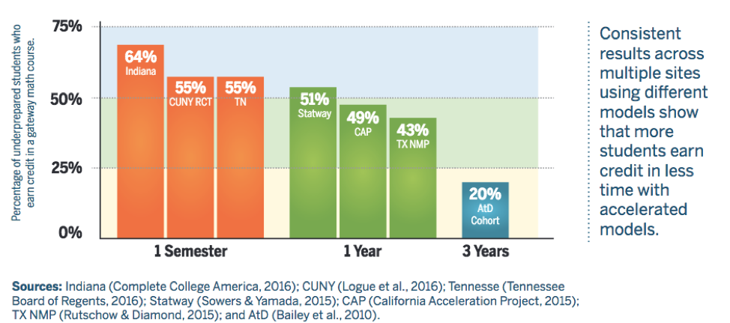
More Students Complete in Less Time with Accelerated Models
https://dcmathpathways.org/sites/default/files/resources/2019-03/CaseforMathPathways_20190313.pdf

Slide 22
Acceleration Models
Condensed Sessions
Combined Courses
Corequisite Structures
Co-mingled
Cohorted
All of these models assume purposeful course sequence design and placement using multiple factors.

Slide 23
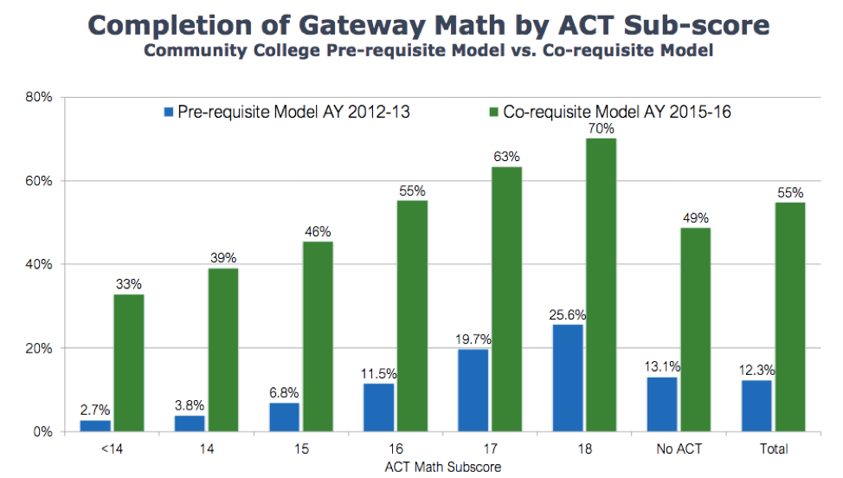
The College System of Tennessee
https://completega.org/sites/default/files/resources/Denley_CoRequisite_Academy_Mathematics_0.pdf
Source: Denley, T., Corequisite Developmental Mathematics
Notes:
Don’t accept the status quo – Uri said “As a professor I still doubt it, but the data is overwhelming.” (re: acceleration) We don’t know better than the data!

Slide 24
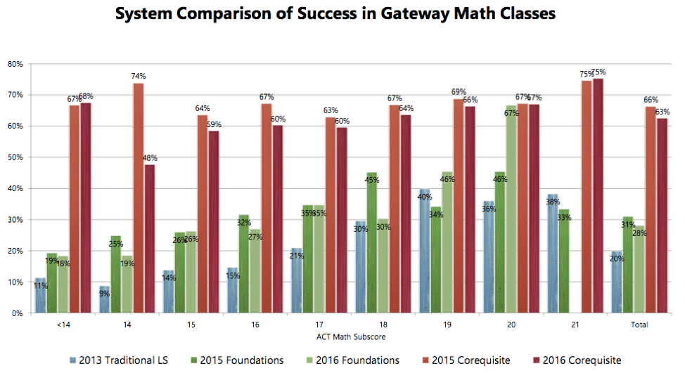
Georgia
https://completega.org/sites/default/files/resources/Denley_CoRequisite_Academy_Mathematics_0.pdf
Source: Denley, T., Corequisite Developmental Mathematics
Notes:
Don’t accept the status quo – Uri said “As a professor I still doubt it, but the data is overwhelming.” (re: acceleration) We don’t know better than the data!

Slide 25
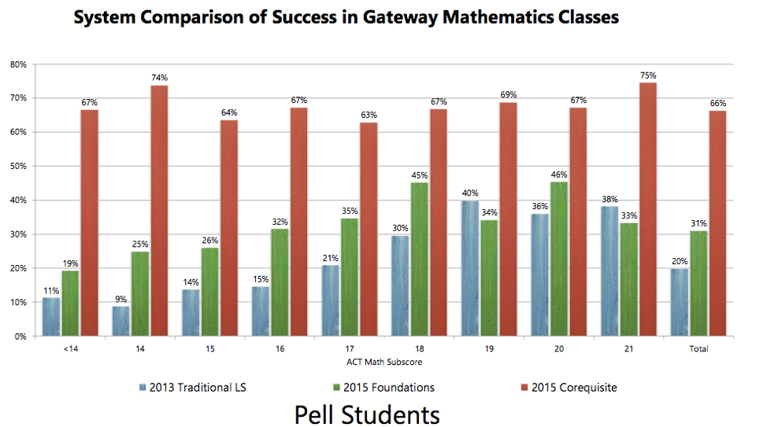
Georgia
https://completega.org/sites/default/files/resources/Denley_CoRequisite_Academy_Mathematics_0.pdf
Source: Denley, T., Corequisite Developmental Mathematics
Notes:
Don’t accept the status quo – Uri said “As a professor I still doubt it, but the data is overwhelming.” (re: acceleration) We don’t know better than the data!

Slide 26
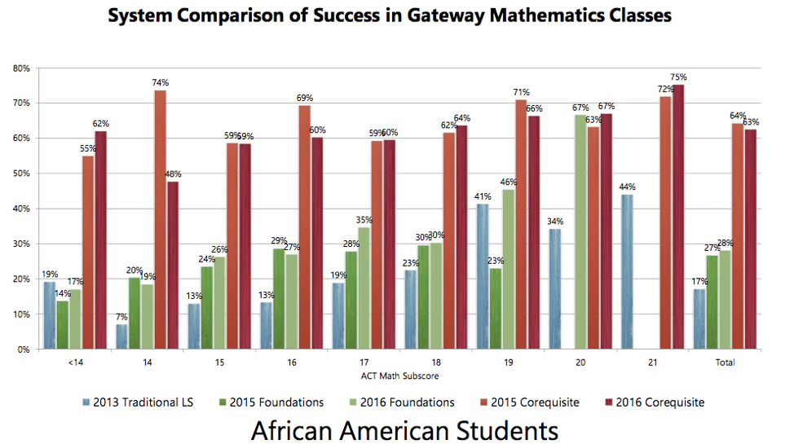
Georgia
https://completega.org/sites/default/files/resources/Denley_CoRequisite_Academy_Mathematics_0.pdf
Source: Denley, T., Corequisite Developmental Mathematics
Notes:
Don’t accept the status quo – Uri said “As a professor I still doubt it, but the data is overwhelming.” (re: acceleration) We don’t know better than the data!

Slide 27
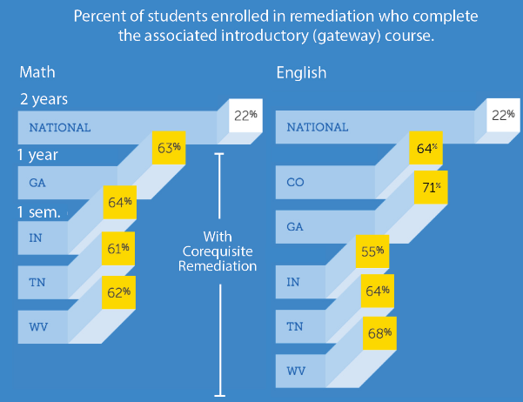
https://dcmathpathways.org/sites/default/files/2016-08/Corequisite%20Remediation_%20Spanning%20the%20Divide.pdf

Slide 28
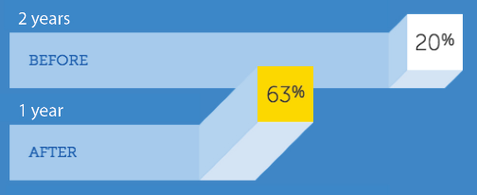
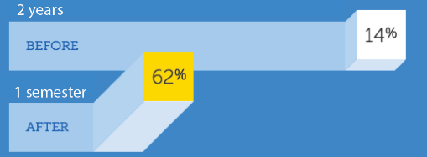
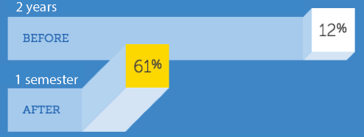
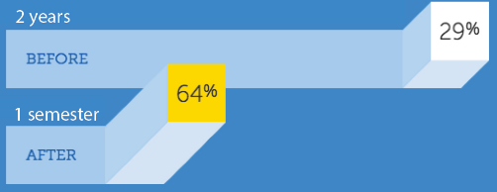
Gateway Math Course Completion Rates Before and After Coresuisite Models
Georgia
West Virginia
Ivy Tech College, Indiana
Tennessee
https://dcmathpathways.org/sites/default/files/2016-08/Corequisite%20Remediation_%20Spanning%20the%20Divide.pdf

Slide 29
Invest in comprehensive supports from enrollment to graduation.
Assessment and Placement (MMCP)
Integrated Academic Supports
Non-Academic Supports
Intensive Advising
Appropriate mathematics for degree
Engaging, culturally responsive pedagogy
Notes:
MMCP – ACPC currently only has policy for College Alg pathway, but employ more broadly to other pathways Equitable and accurate methods are used to determine every student’s readiness for college level mate
Intentional advising. Default mathematics by program. Probe deeper with undecided students – art or engineering? At least get in the ballpark (meta-major) to identify math pathway. No more algebra-for-all. Take math first semester, continuous math enrollment continued advising through transfer or completion
Academic supports: co-requisite, tutoring, ABE partnerships, supplemental instruction, Student Success courses
Non-Academic supports: case managers, check and connect, counselors, help with identifying resources for transportation, child care, health, mental health issues

Slide 30
Math Pathway Implementation

Slide 31
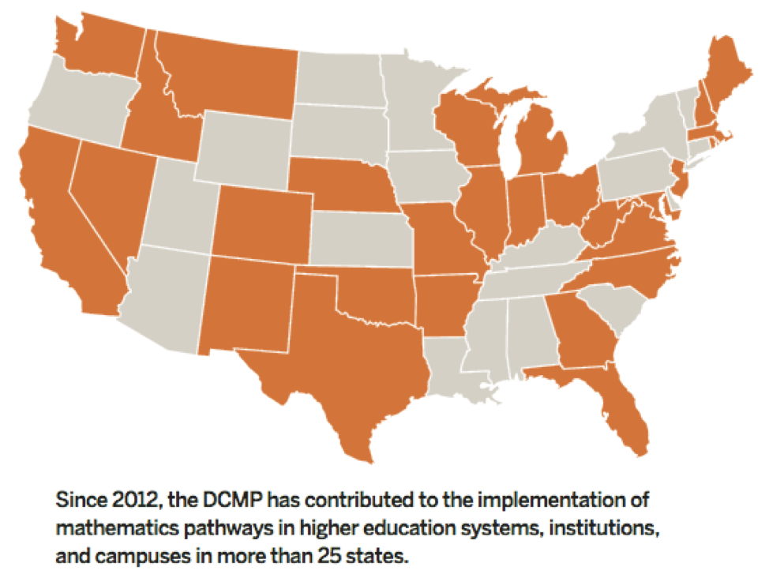
Math Pathways across the Nation
https://www.utdanacenter.org/sites/default/files/2019-03/DCMP-one-pager_FINAL.pdf

Slide 32
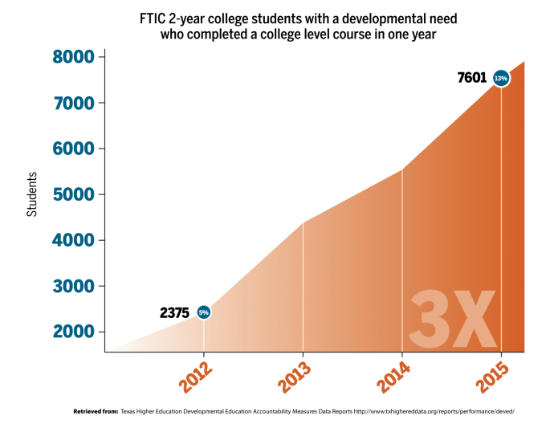
Texas Math Pathways to Completion
FTIC = First Time in College

Slide 33
Implementing Math Pathways
Relevant math course default by meta-major across the system
Purposeful inclusion of relevant algebra
Placement reform
Equitable access to pathways
Acceleration structures
Comprehensive, integrated supports
Professional development
Notes:
Transfer into the major, not just as goal 4, appropriate courses chosen (like transfer pathways), QR when appropriate, Reframe QR as "best choice for meta-major" (not "course for dummies"), truly engaging and relevant QR course
Algebra-based courses like Intermediate Algebra not required prerequisites to QR and Stats
Placement reform: QAS ACCUPLACER for Stats and QR, consider other indicators of success, don't base on algebra tests or completion, let students on the bubble access courses with supports
Acceleration options – corequisites, combined courses
Supports: ABE partnerships, corequisites, check and connect, student success courses requirements, additional contact time, supplemental instruction
PD for pedagogy, corequisite development and implementation, strategies for supporting students where they are
These are intended to be done as a package, not just pieces!
AMPD, DESR, SLO groups contributing to this

Slide 34
Math Pathways Initiatives Should NOT
Imply that students cannot learn algebra or advanced mathematics
Eliminate developmental education
Require identical degrees, programs, or courses across the system
Decrease rigor expectations
Place underprepared students in courses where they have little chance of success
Notes:
Success in math is a pedigree that confirms or denies access to educational privilege. Also, QR is not "algebra-free" - just more purposefully-selected, relevant, applied algebra.
College Algebra may contain some critical thinking and problem-solving, but it isn’t the main focus. Highly procedural.
Be clear –this doesn’t mean we think students can’t learn algebra. They just don’t have to.
Math isn’t just for physics and engineers, but that’s the only mathematics we ever teach!
Placement is often based on algebra performance; dev ed courses often algebra based

Slide 35
Our Vision
An appropriate default math course is established for every program or major (even when choice is allowed).
Rigorous, relevant, interesting Quantitative Reasoning courses are available across the system and transfer into the major (when appropriate) at all universities.
The majority of students place directly into college-level math courses (with co-requisite supports if needed).
Developmental mathematics courses are aligned to college-level content.
Every student has an opportunity to complete the first college-level math course in one year or less.
Every student is advised into a high-quality, rigorous mathematics pathway based on their academic goals.
All Minnesota State Colleges and Universities invest in comprehensive supports from enrollment through graduation.
Notes:
Use data to find out – are your results good enough? Equitable? Are students continuing? Could they have been successful if they had the chance? Do students switch to stem majors from non-stem? How many? Continue to monitor stats as the program progresses
Consider acceleration in STEM, too! Why is algebra the exception?

Slide 36
Join the Joyful Conspiracy
Dana Center Math Pathways Workshop and Webinar Series
  First webinar: Tuesday, October 22
  Fall workshop: November 13-14 @ SCTCC
  Travel paid for by AMPD and Greg Rathert's office
  Three additional webinars: dates and topics TBD
  Spring workshop: dates TBD @ SCTCC
Learn more about DCMP at https://dcmathpathways.org/dcmp
Katie Smieja
ksmieja@sctcc.edu
Sarah Bustrom
sarah.bustrom@lsc.edu
Jenny Joa
jennifer.joa@hennepintech.edu
Notes:
“The Joyful Consipracy” - Uri Treisman
PD to help us do this – it's not what we're used to, so will take some learning and trying to implement
not a magic bullet! Will still only have 60-70% pass rates – but wow, if we could do that – and in a shorter amount of time?
If this can be done successfully in other states across the nation, why resist it here? What do we think is so different about our students that they cannot succeed if we give them the chance and we support them?
What if this really works? What’s the worst that happens if it doesn’t? even if it doesn’t lead to completion rates , at least the barrier won’t be math

