Slide 1

Universal Design for Learning
The Why, The What
The HOW
Melissa Fletcher, MA
Allison Jenson, MA

Slide 2
Today's plan
When we finish this morning, you should:
Have deeper understanding of the what, why, and how of Universal Design for Learning
Have concrete strategies that you can apply in your classroom, lesson plans, or assignments
Today's agenda:
Group presentation (approximately 25 minutes)
5 minute break
Collaborative work time (20 minutes)
Share outs/questions (10 minutes)
​
Questions:
This is interactive, ASK​
Write down on notecards

Slide 3
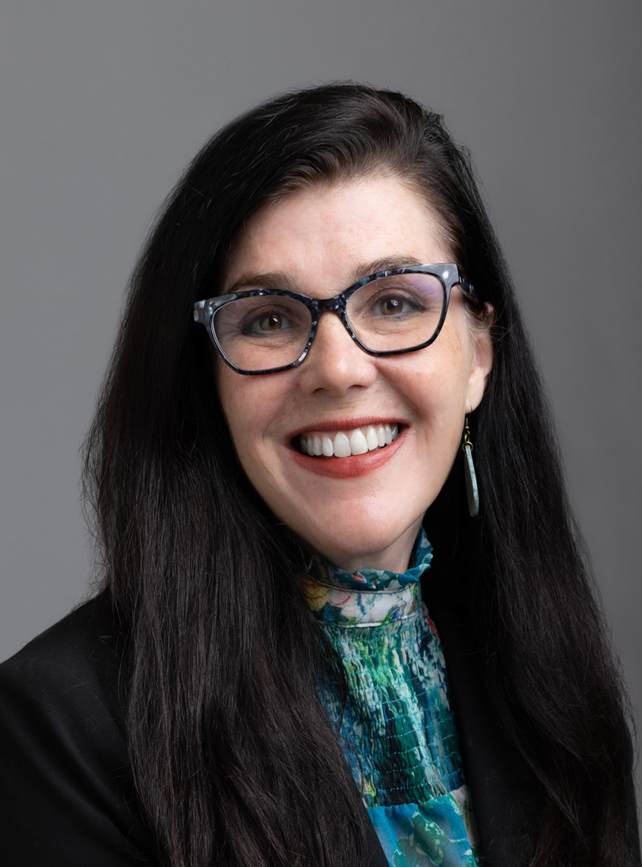
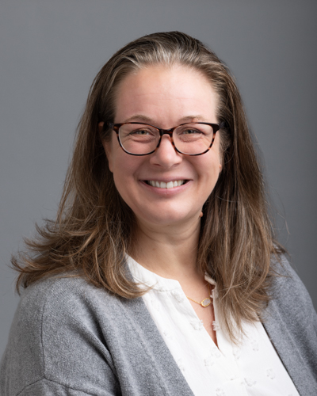
Who we are
Melissa Fletcher (she/her)
  Melissa is the Director of Educational Access and Disability Resources at Dakota County Technical College. Experience includes private and large public college institutions, corporate and non-profit consulting for over 20 years.
Allison Jenson (she/her)
  Allison is the Director of Accessibility Resources at Inver Hills Community College. After spending 16 years working in the K-12 setting as a special education teacher and support specialist, she has enjoyed working in the post-secondary setting. Allison holds a Master's degree in Special Education with additional course work in Autism Spectrum Disorder.

Slide 4
WHY Universal Design for Learning?

Slide 5
The Reason for UDL
Goal: Every learner can access and engage with course content.
Reduces need for accommodation “ask” (when possible)
Outside of disability accommodation, includes other student learners
  Language Needs
  Situational Needs
  Unidentified disabilities: as many as 60% of students who could qualify for accommodations do not request them.
Notes:
Shannon would like to speak on this one! She will have points to report on ☺ Highlight the last slide as important as we may see increases in this in the next few years

Slide 6
Centering the Work
Students with access needs are
increasing in Higher Education:
Students with Mental Health Needs and Neurodivergence increasing in numbers
Diagnosis is a privilege:
  Diagnostic services are more stressed than ever
  Several months, sometimes years, on waitlists
Lingering effects of the pandemic impact preparation in post-secondary setting.
Services for students have been reduced.
Many students choose not to disclose diagnoses on campus.
The needs are in our classrooms today, whether identified or not.

Slide 7
WHAT is
Universal Design for Learning Anyway?

Slide 8

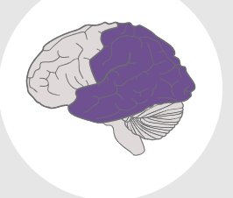
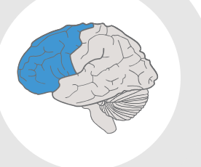
Universal Design for Learning
Engagement
Representation
Expression

Slide 9
Universal Design for Learning (UDL) is a research-based educational framework :
Engagement:
How are learners motivated to learn?
Representation:
How do learners get information?
Expression:
How to learners show what they know?

Slide 10
HOW is UDL Implemented?

Slide 11
The following link is a video on UDL
What and How of UDL?
John Spencer

Slide 12
Engagement: Class Climate starts before they walk through the door.
WELCOMING (NEW to UDL)
WHAT IS YOUR STUDENTS’ WHY?
  Why are your students taking in the course?
  What are their expectations?
  What generally motivates them to participate?
  What do they hope to do in the future?
Ask students how they learn and recall:
  Pre-class survey
  First day of class discussion
  Lecture? Self-learning? Hands-on?
  All of them!
Notes:
Melissa can do engagement

Slide 13
Engagement:Student Choice and Student Voice
Syllabus statement about support
Invite students to meet to discuss/clarify/ communicate in multiple ways
Involve students in course options
Clarify expectations of respect for everyone

Slide 14
Representation: Physical Access, Usability and Safety
Ensure activities, materials, and equipment are physically accessible, usable and safe by all students.
Repeat printed directions orally/write oral directions down
  Provide visual representation of classroom routines and expectations
Captioned videos, transcribed podcasts
Flexibility of location for learning

Slide 15
Representation: Digital Access
Ensuring all digital course access is:
Accessible:
  Documents are accessible
  Videos are CAPTIONED clearly
    Automated captions may not be sufficient for students with access needs.
Easy to navigate
  Assignments are clearly outlined
  Course content is easy to access and consistent
  Due dates are outlined
Notes:
Chad would like to speak on this one—Melissa will provide narrative to ensure captioning is accurate

Slide 16
Representation: Course Delivery Methods
Use multiple accessible instructional methods to deliver course content:
  Lecture
  Pre-recorded videos
  “Front-load” important vocabulary
  Voice to text/text to voice technology
  Collaborative learning options (pairing?)

Slide 17
Representation: Course Delivery Methods
Use multiple accessible instructional methods to deliver course content:
  Hands-on activities
    Card sorts
    Graphic organizers
    Role plays/case studies
  Educational software outside of class
    Check for accessibility!
  Internet-based options to support learning
  Community based learning opportunities
  You can use more than one method!

Slide 18
Representation:
Course Content and Information
Course materials, notes, and other informational resources are accessible to all students
  Prepare syllabus and distribute in advance
  List assignments – share changes verbally and in writing
    Provide detailed rubrics so students know what the assignment should look like
  Texts: E-text/Print/OER
  Use searchable PDFs
  Accessible Print Materials
  Provide options for notes:
    Copies of faculty notes
    multiple peer note takers or group notes,
    providing recordings
    Assistive Technology options

Slide 19
Action and Expression:
Feedback and Assessment
Regularly assess student progress using multiple, accessible methods and adjust instruction accordingly
Allow students to turn in parts of a large project for review
Allow shorter quizzes instead of longer exams
Allow alternate ways to demonstrate learning: videos, one: one, papers vs. projects vs. testing
Soft and hard deadlines, ability to ”re-do”
Provide a detailed rubric for self-assessment
Setting up time accommodations in D2L ahead of time and ensuring the test to the testing center when needed.

Slide 20
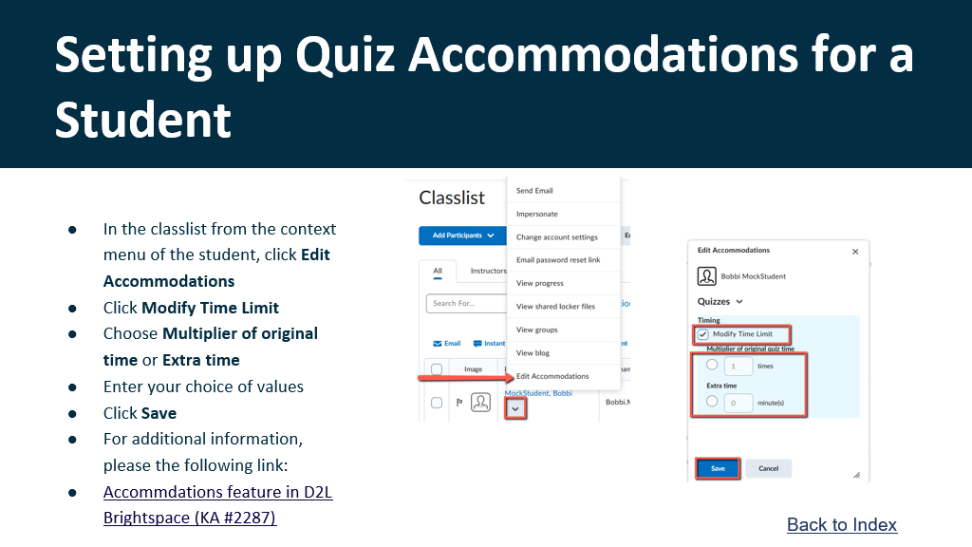
Setting up assessment accommodations in D2L

Slide 21
Common Concerns:
Technical Requirements: YES!
Academic Rigor: What does this mean?
Preparing Students for Working World?

Slide 22

Break:
After the break, you will need:
1. Your class work, if you chose to bring something
2. A writing utensil or computer
3. A plan to work with a partner, if you choose to do so.
4.Access to the digital or physical resource folder

Slide 23
Application Time:
Option 1: Think of an assignment, assessment, or area of need in your class right now. Use the UDL principles to revise your approach. What might you want to do differently on Monday?
Option 2: Use one of the scenarios provided to build a UDL plan for a hypothetical situation.
Work can be done individually or with partners. Please be aware of your noise level and potential impact on others. Feel free to move around the space.

Slide 24

Collaboration time

Slide 25

Share out ideas, questions, concerns, wonders...
Reminder: Universal Design, like all best practices in teaching, is more about action research than arriving at a destination. We appreciate your partnership as we all learn and grow!

Slide 26
Resources Examples
Information
Credits
National Center on Universal Design for Learning
  Multiple Short YouTube Videos
CAST: Center for Applied Center for Technology
  Understanding the Universal Design for Learning Approach
DO-IT: Disabilities, Opportunities, Internetworking, and Technology
  University of Washington The Center for Universal Design in Education
  in Education
The NORA Project:
  Universal Design for Learning
NOVAK Educational UDL Resources for Educators:
  NOVAK Resources
  Add video
  Contact Information:
  Melissa: melissa.fletcher@dctc.edu
  Allison: allison.jenson@inverhills.edu

