Slide 1


Increasing Enrollment in Developmental Courses Through Targeted Schedule Blocking And Advising
Sara McDonald and Katie Smieja

Slide 2
Redesigning Developmental Curriculum
Streamilining the developmental sequence to “shorten the pathway”
Updating existing curriculum to be more specific yet adaptable to diverse student needs
Creating new curriculum to fill gaps and better prepare students for college study

Slide 3
Target Redesign Areas
Developmental English and Reading
  Streamlining Dev Ed pathway by combining courses, shifting ACCUPLACER cut scores, adopting a Comp I & II model for Goal 1
English for Speakers of Other Languages
  9 new courses: three courses at three different levels, focusing on listening & speaking, reading, and writing
Mathematics
  Updated lowest level course, and added a new course combining preparations for a variety of math requirements to fit different programs of study

Slide 4

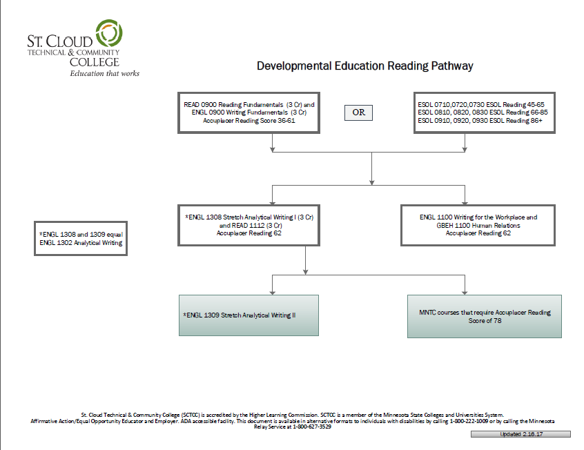
New Developmental Pathways

Slide 5
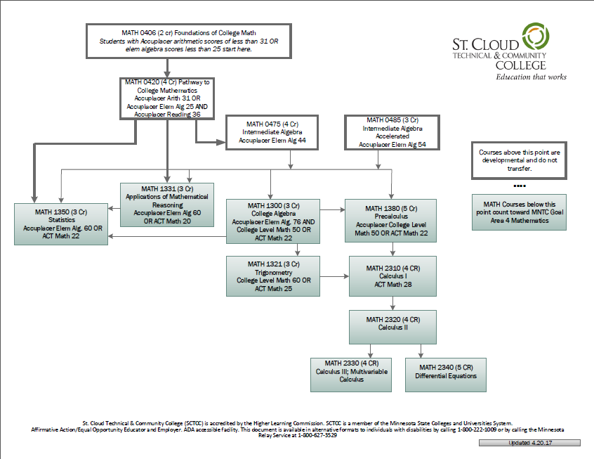
New Developmental Pathways

Slide 6

Next Step: Scheduling
Goals:
Make it possible for students to take 12 credits per semester
Provide several different time/day options for students to include 12 credits worth of classes into their schedules.
Use scheduling as a tool for increased enrollment and retention

Slide 7
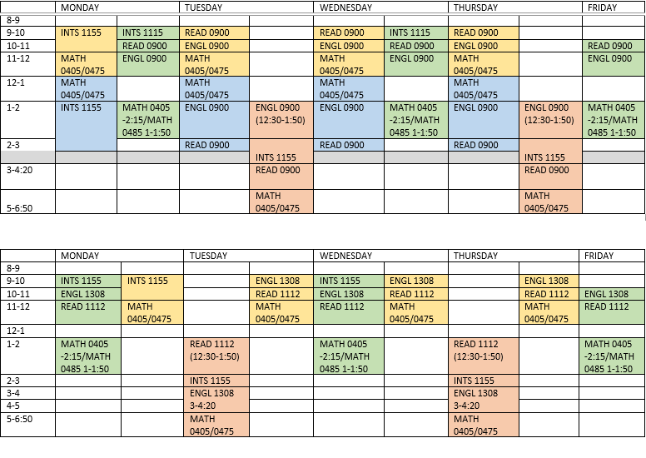
Blocked Schedules

Slide 8
Advising Updates
Concurrent with the Developmental redesign, advising was redesigning their model
“Flipped Advising”
Perfect opportunity to interact individually with students and direct registration choices

Slide 9

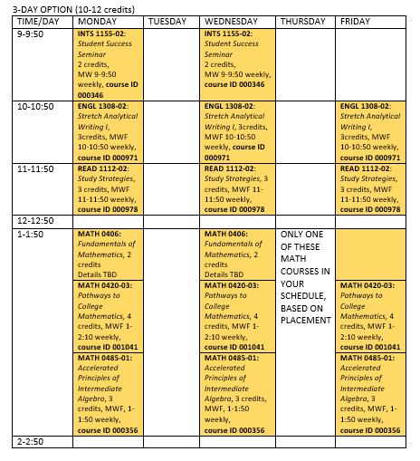
Quick Reference Schedules

Slide 10
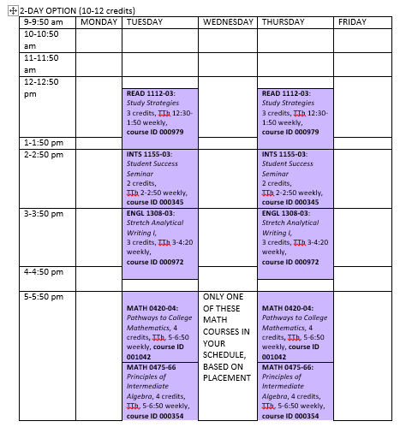
Quick Reference Schedules

Slide 11
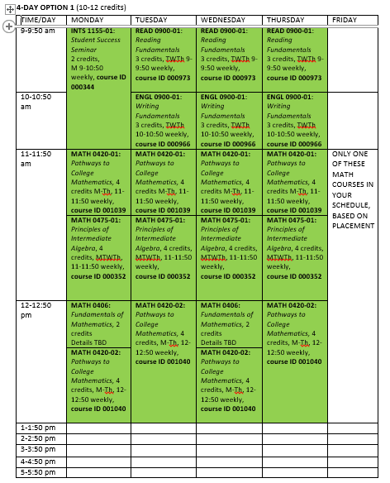
Quick Reference Schedules

Slide 12
Effects
By the end of Spring 2017, we were already seeing increases in Dev Ed enrollment
By midsummer, enrollment in Dev Ed had increased by roughly 50% overall
From fall 2016 to fall 2017:
  Number of Dev Ed Math sections needed increased 38%, and Math courses for fall 2017 are roughly 90% full
  Number of students enrolled in Student Success Seminar increased 25%

Slide 13
Thank you!
May we answer any questions?
smcdonald@sctcc.edu
ksmieja@sctcc.edu

