Slide 1
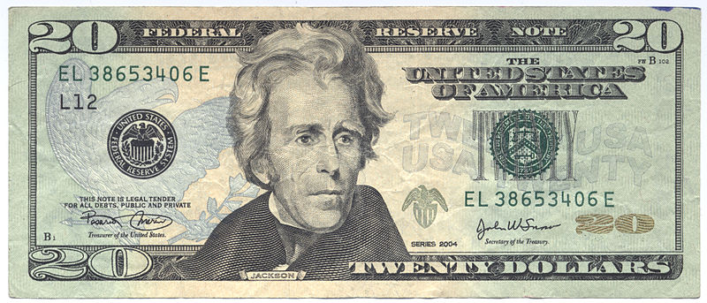
“Only 20 bucks?” Low-cost Reading Textbook Alternatives
Patti Gage
Celeste Mazur
Saint Paul College

Slide 2

Open Source Materials
Open Textbook Library https://open.umn.edu/opentextbooks/
MnSCU/Minnesota State Open Textbook Initiative/Open Textbook Network
http://www.asa.mnscu.edu/educationalinnovations/open/index.html
Saint Paul College - workgroup to explore open source materials usage
The process: download/assemble pdf, barcode, copied by the copy center, bookstore sells.

Slide 3

Open Source Textbook Activities
Background knowledge pre-assessment
Textbook chapter academic vocabulary lists and activities – quizzes, practice, etc.
Summary writing of chapter sections
Annotation of chapters
Synthesis of article/video information with textbook chapters
Small-stakes recall activities in class – Kahoot, group recall, etc.
Quiz/test questions on chapter content

Slide 4

Article Reading
Library Database
  Academic Search Premier: General multi-disciplinary database
  Opposing Viewpoints: Good source for examining arguments/opinions
  ProQuest Newspapers: includes 300+ U.S. & international news sources
Online News Sources
  New York Times, The Washington Post, Star Tribune
  BBC News, CNN
  Article of the Week: Kelly Gallagher
  Voice of America
  Newsela

Slide 5

Article portfolio assignment
5 week project, 2 articles a week
Students receive a schedule of weekly reading topics
Article 1 (provided by instructor), Article 2 = student’s choice
Students must use the college’s library database
Students must read and annotate each article and be prepared to discuss the main points of Article 1 in class
After completing their reading portfolio, students choose one of their portfolio topics for their final research project

Slide 6

Discussion/Idea Share
How do you see using Open Source textbooks in your teaching setting?
What are other sources you’ve used for articles and other texts?
Besides a portfolio, what are other article-based assignments you’ve used?
Other ideas?

Slide 7
Other ideas!
topic/theme focus for article portfolio
student-created wiki page or blog, electronic collection – blogger, sway
variety of textbook chapters for student choice

